Slide 1
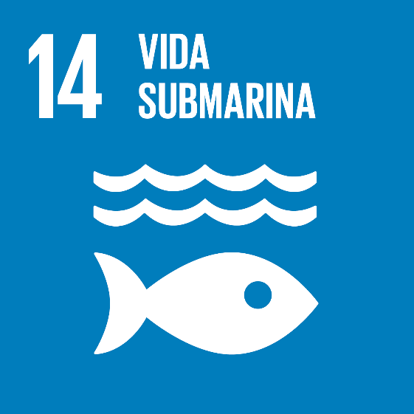
CLIMATE ACTION PROYECT
Protect Underwater Life Pablo Manzanares 1ºESO-B

Slide 2
The United Nations Sustainable Development Goals (SDGs) are the result of an agreement reached by the United Nations Member States and are made up of a Declaration, 17 Sustainable Development Goals and 169 targets. Member States have agreed to try to achieve them by 2030.

Slide 3
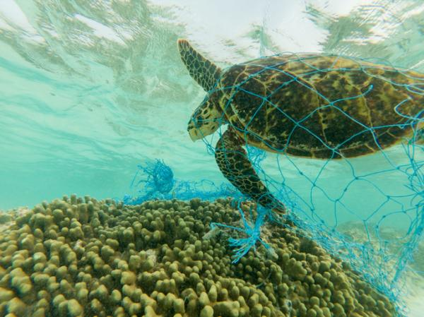
14.Underwater life
The oceans represent more than 70% of the earth's surface and are home to 97% of the water that exists on the planet. Due to the large volume they occupy, around 99% of the total land volume, these large masses of salt water represent the home of thousands of plant species, animals, bacteria and other microorganisms, as well as an important source of natural resources. Unfortunately, the human being has found another way to take advantage of these immense aquatic spaces, turning them into the new human landfills, which translates into the pollution of the oceans.

Slide 4
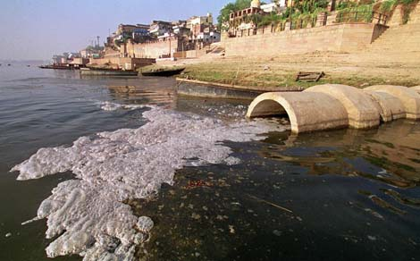
1.Causes or consequences
Chemical products All kinds of chemicals can be found in the ocean as a result of deliberate spills or transport from continents and coasts. This range extends from heavy metals and radioactive waste from industries to medicines, drugs and hormones, among others. The effects of these substances are death by poisoning in the most extreme cases, the appearance of malformations, different metabolic and behavioral disorders, and bioaccumulation in the trophic chain, which can reach us again

Slide 5
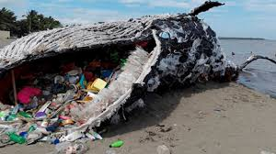
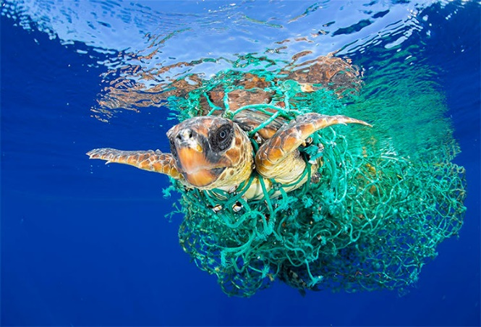
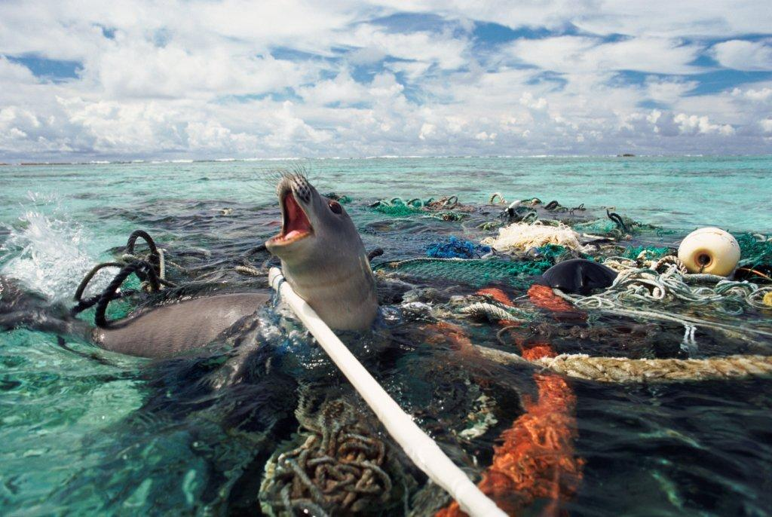
2. Causes and consequences
Trash can travel through all the world's rivers and oceans, and accumulate on beaches and in ocean gyres. These wastes damage physical habitats, transport chemical pollutants, threaten aquatic life, and interfere with human use of rivers and river, marine and coastal environments.

Slide 6
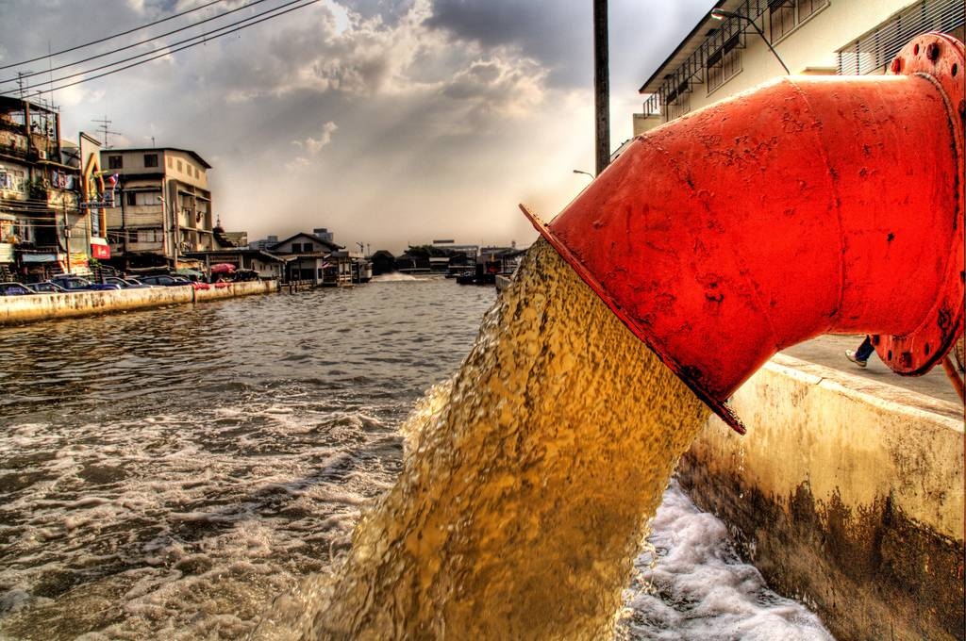
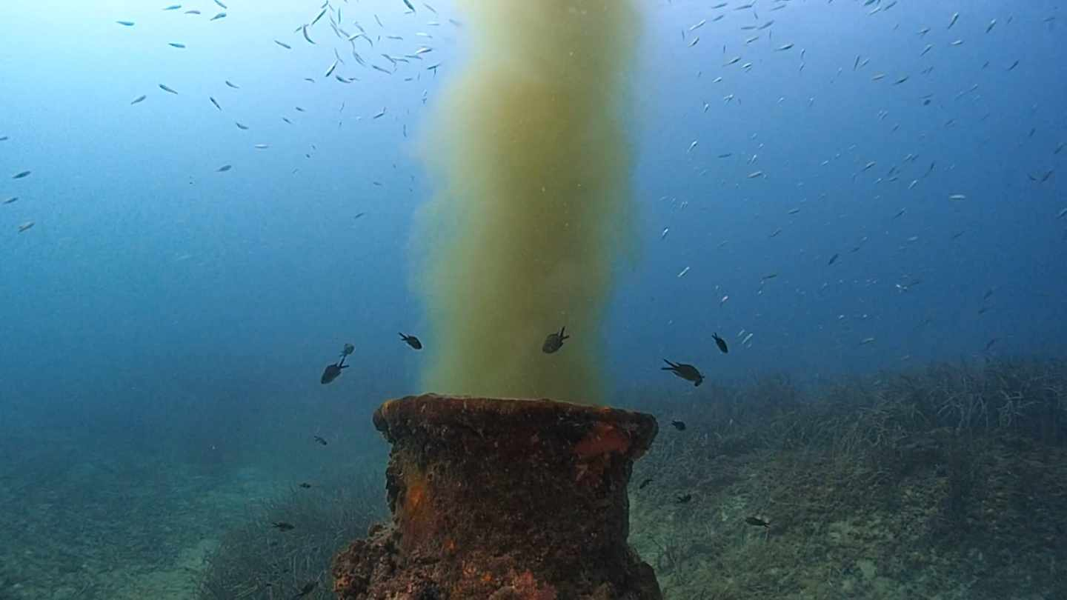
3.Causes and consequences
And what are the main consequences that this causes? First, the disappearance of biodiversity and aquatic ecosystems. Also the human being is very harmed due to the alteration in the food chain and contracts diseases when drinking or using contaminated water.

Slide 7
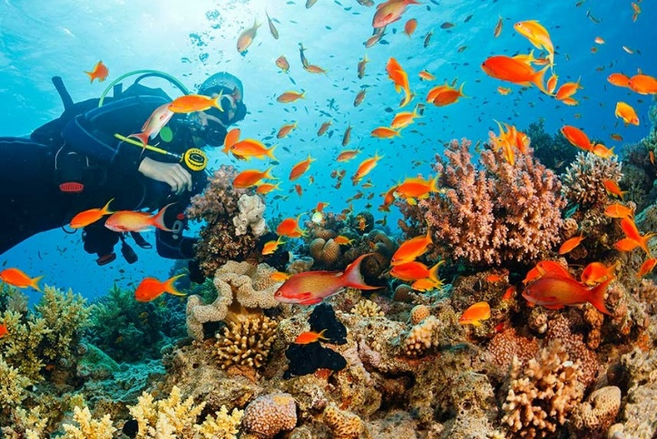
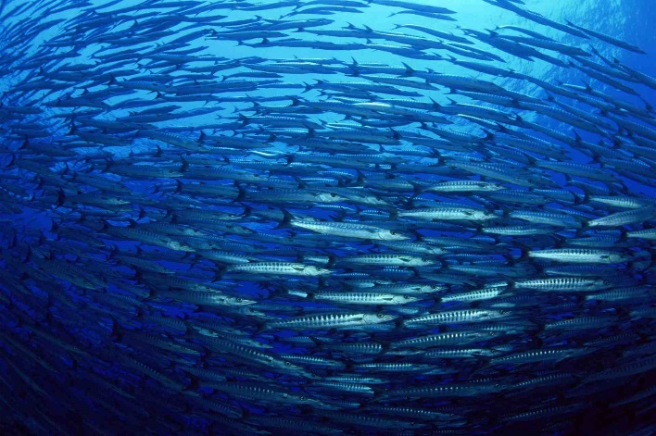
Solutions
-Ban the use of disposable plastics and adopt garbage control policies.
-Reduce or recycle plastic
-Reduce the discharge of sewage without treatment
-Control chemical and industrial pollution.
-Improve financing for the prevention and control of marine pollution.

