Slide 1
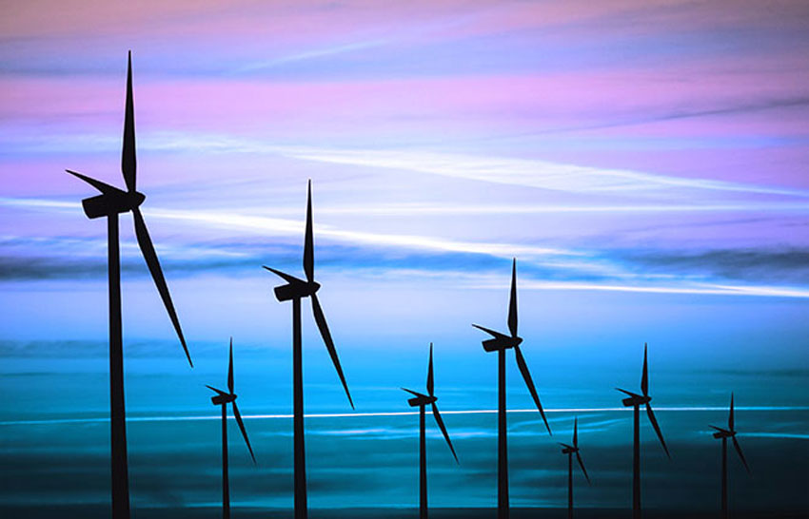
THE EOLIC ENERGY
Aurora Delgado Alijo Clase:3ºA ESO

Slide 2
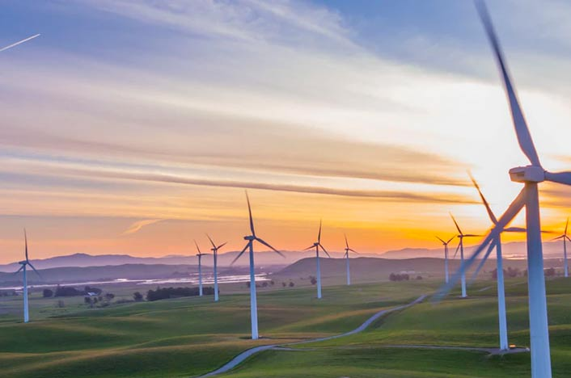
Where do we install it? And why ?
The uncertainty about the behavior of the wind is the main handicap when installing a wind farm, especially in places with complex orography. It is useless for an area to have the ideal conditions for the generation of wind energy if there is no nearby community that can consume it.

Slide 3

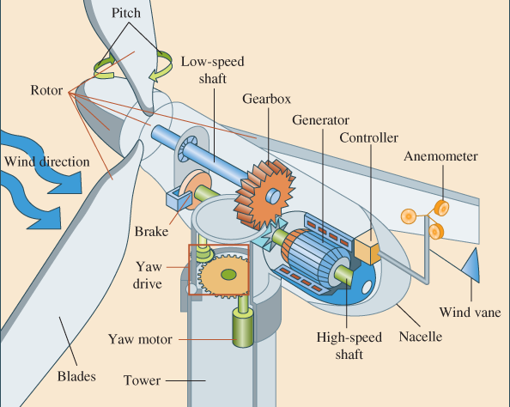
2. What elements compose it?
Gondola.
Rotor.
Blades.
Low-speed shaft.
Nacelle.
High-speed shaft.
Electric generator.
Electronic controller.
Pitch.
Tower.
Yaw motor.
Anemometer.
Gearbox.

Slide 4

3. What function does each element have?
And what relationship do they have between them?
Gondola: It is the housing that protects the key components of the wind turbine.
Rotor blades: They capture the wind and transmit their power to the hub. They have a length of 20 m.
Bushing: It is an element that joins the rotor blades with the low speed shaft.
Low speed shaft: Connect the rotor hub to the multiplier. It spins very slow, at 30 rpm.
Multiplier: Allows the high speed shaft to your right to rotate 50 times faster than the low speed shaft.
High speed shaft: It rotates at approximately 1,500 rpm, which enables the electric generator to operate.
Electric generator: In modern wind turbines the maximum power is usually between 6 and 12MW.
Electronic controller: It is a computer that continuously monitors the conditions of the wind turbine and controls the orientation mechanism.
Refrigeration unit: It contains an electric fan used to cool the electric generator.
Tower: Supports the nacelle and rotor. It is generally an advantage to have a tall tower, as the wind speed increases as we move away from ground level.
Orientation mechanism: It is activated by the electronic controller, which controls the wind direction using the panel. Anemometer and panel: The electronic signals from the anemometer connect the wind turbine when the wind has a speed of approximately 5m / s.

Slide 5
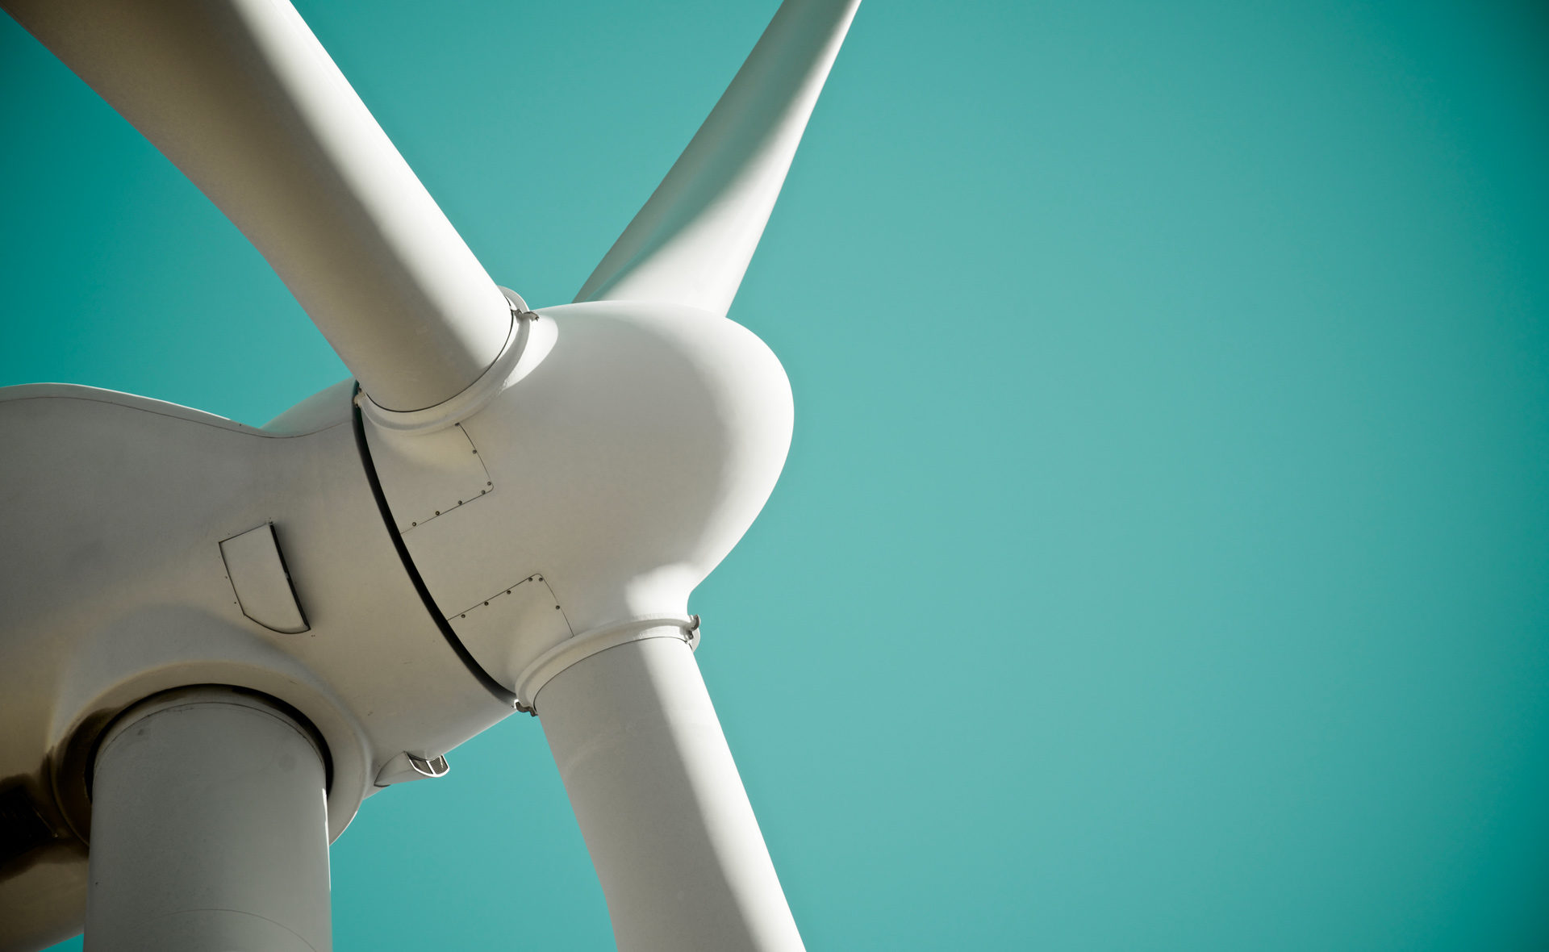
4. What kind of energy does it produce?
Wind energy is a renewable energy source that is obtained from the kinetic energy of the wind that moves the blades of a wind turbine, which in turn starts a turbine that converts it into electrical energy. Wind energy is the energy obtained from the wind. It is a type of kinetic energy produced by the effect of air currents. We can convert this energy into electricity through an electric generator.

Slide 6

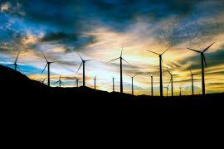
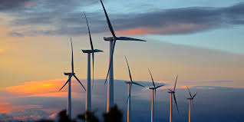

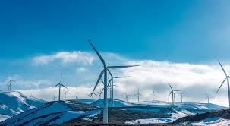
5. How do you transport or transform that energy?
This energy is direct current, which travels up the huge mast to a converter at the base. This converter will transform direct current into alternating current and the transformer will raise its voltage so that it is possible to distribute the electricity with the lowest possible losses. A wind turbine is a machine that transforms wind energy into mechanical energy through oblique blades attached to a common axis. The rotating shaft can be connected to various types of machinery, be it for grinding grain (mills), pumping water or generating electricity.

Slide 7

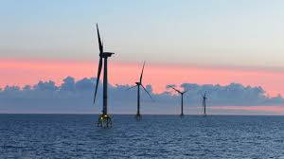
6. What is the maximum power you can get?
The wind power installed in the world has exceeded 651 GW. During 2019, the world wind power has increased by 60.4 GW. ... In Europe, in 2019, the new power has been led by the United Kingdom, Spain and Germany (new power 15.4 GW in 2019). The wind turns the blades, which begin to move at wind speeds of around 3.5 m / s and provide maximum power at around 11 m / s. With very strong winds (25 m / s) the blades are placed in a flag position and the wind turbine is braked to avoid excessive stresses.

Slide 8


7. How does this energy and its obtaining affect the environment?
Wind energy is a renewable energy source, it does not pollute, it is inexhaustible and reduces the use of fossil fuels, the origin of the greenhouse effect emissions that cause global warming.

