Slide 1
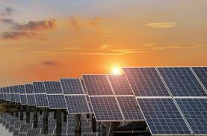
PHOTOVOLTAIC ENERGY
Jose Luis Mérida luque
3 eso a

Slide 2
INDEX
1. InstalATION
2. ComposiTION
3. funcTION AND RELATIONSHIP
4. energY PRODUCED
5. transport AND TRANSFORM OF THE ENERGY
6. MAXIMUM POTENTIAL
7. ENERGY AND ENVIRONMENTAL

Slide 3
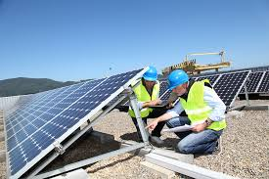
INSTALATION
IT’S ABOUT A SPACE, NOMRALLY LOCATED ON OLD AGRICULTURAL OR FIELD LAND.
THESE INSTALLATION CAN BE OWNED BY SEVERAL DIFFERENT OWNERS AND THE ADVANTAGE IS THAT ALL OF THEM CAN SAHARE THE INFRASTRUCTURE, LAND AND SERVICES, SUCH AS CONNECTION TO THE NETWORK.

Slide 4
COMPOSITION
PHOTOVOLTAIC SOLAR MODULE
SUPPORTS
CHARGE REGULATOR
BATTERY
INVERTER

Slide 5
Functions and relationships
PHOTOVOLTAIC SOLAR MODULE
SUPPORTS
CHARGE REGULATOR
BATTERY
INVERTER

Slide 6
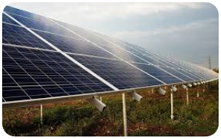
PHOTOVOLTAIC SOLAR MODULE
IT’S THE MAIN ELEMENT OF PHOTOVOLTAIC SOLAR INSTALLATIONS, IT CONVERTS THE SUN’S ENERGY INTO DIRECT CURRENT ELECTRICAL ENERGY.
THESE PHOTOVOLTAIC PANELS ARE MADE UP OF CELLS OF SILICON, WHICH IS A SEMICONDUCTOR MATERIAL. THESE CELLS ARE ENCAPSULATED AND ELECTRICALLY CONNECTED TO EACH OTHER.
THE MODULES CAN BE MONOCRYSTALYNE, POLICRYSTALLINE OR AMORPHUS.

Slide 7
CHARGE REGULATOR
THESE PHOTOVOLTAIC COMPONENTS HAE THE FUNCTIO OF MANAGING ENERGY EFFICENTLY.
THEY ARE THE LINK THAT LINKS THE SOLAR PANELS WITH THE OTHER PHOTOVOLTAIC COMPONENTS OF INSTALLATION
IT ALLOWS YOU TO EXTEND BATTERY LIFE BY PREVENTING THE SYSTEM FROM OVERCHARHING OR OVER DISCHARGING.

Slide 8
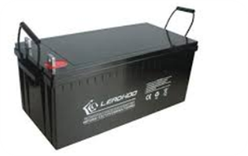
BATTERY
Therefore, the mission of batteries can be summarized in three main functions. The first is to store energy for a certain period of days. The second is to provide a high instantaneous power, and finally, these photovoltaic components set the working voltage of the installation.

Slide 9
INVERSOR
The function of these photovoltaic components is to convert direct current into alternating or conventional.
he main characteristics that these photovoltaic components must have are:
High efficiency, since it must operate at a wide range of powers
Low no-load consumption, that is, when no loads are connected
High reliability or resistance to starting spikes
Safety and short circuit protection
Good regulation of output voltage and frequency

Slide 10
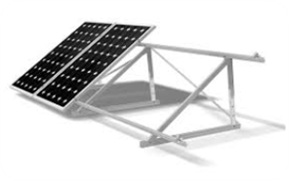
SUPPORT
These are passive elements within the set of photovoltaic components of a solar energy system. That is, they keep the photovoltaic modules in place, since they must have a fixed position that projects in a southward direction. Beyond fixation, they have no other function. With the exception of these, all photovoltaic components of photovoltaic solar installations must be energy efficient.

Slide 11
Energy produced
Photovoltaic energy is the direct transformation of solar radiation into electricity. This transformation occurs in devices called photovoltaic panels. In photovoltaic panels, solar radiation excites electrons in a semiconductor device, generating a small potential difference. The series connection of these devices allows to obtain greater potential differences.

Slide 12
Transport and transform energy
Electric energy circulates through the transmission network in the form of alternating current, therefore, the current generated in the solar panels is conducted to the power room, where the direct current that is received in the DC cabinet is converted into alternating current by means of inverters and later collected in the alternating cabinet. Once converted to alternating current, the electrical energy produced passes through a transformation center where a transformer adapts the current intensity and voltage conditions to those of the transmission network for use in consumption centers.

Slide 13
MAXIMUM POTENTIAL
Bhadla Solar Park
2.245 MW
India
1 mw = 1 000 kw

Slide 14
ENERGY AND ENVIRONMENT
Photovoltaic solar energy, like other renewable energies, constitutes, compared to fossil fuels, an inexhaustible source, contributes to the national energy self-sufficiency and is less harmful to the environment, avoiding the effects of its direct use (atmospheric pollution, waste , etc) and those derived from its generation (excavations, mines, quarries, etc.).

