Slide 1
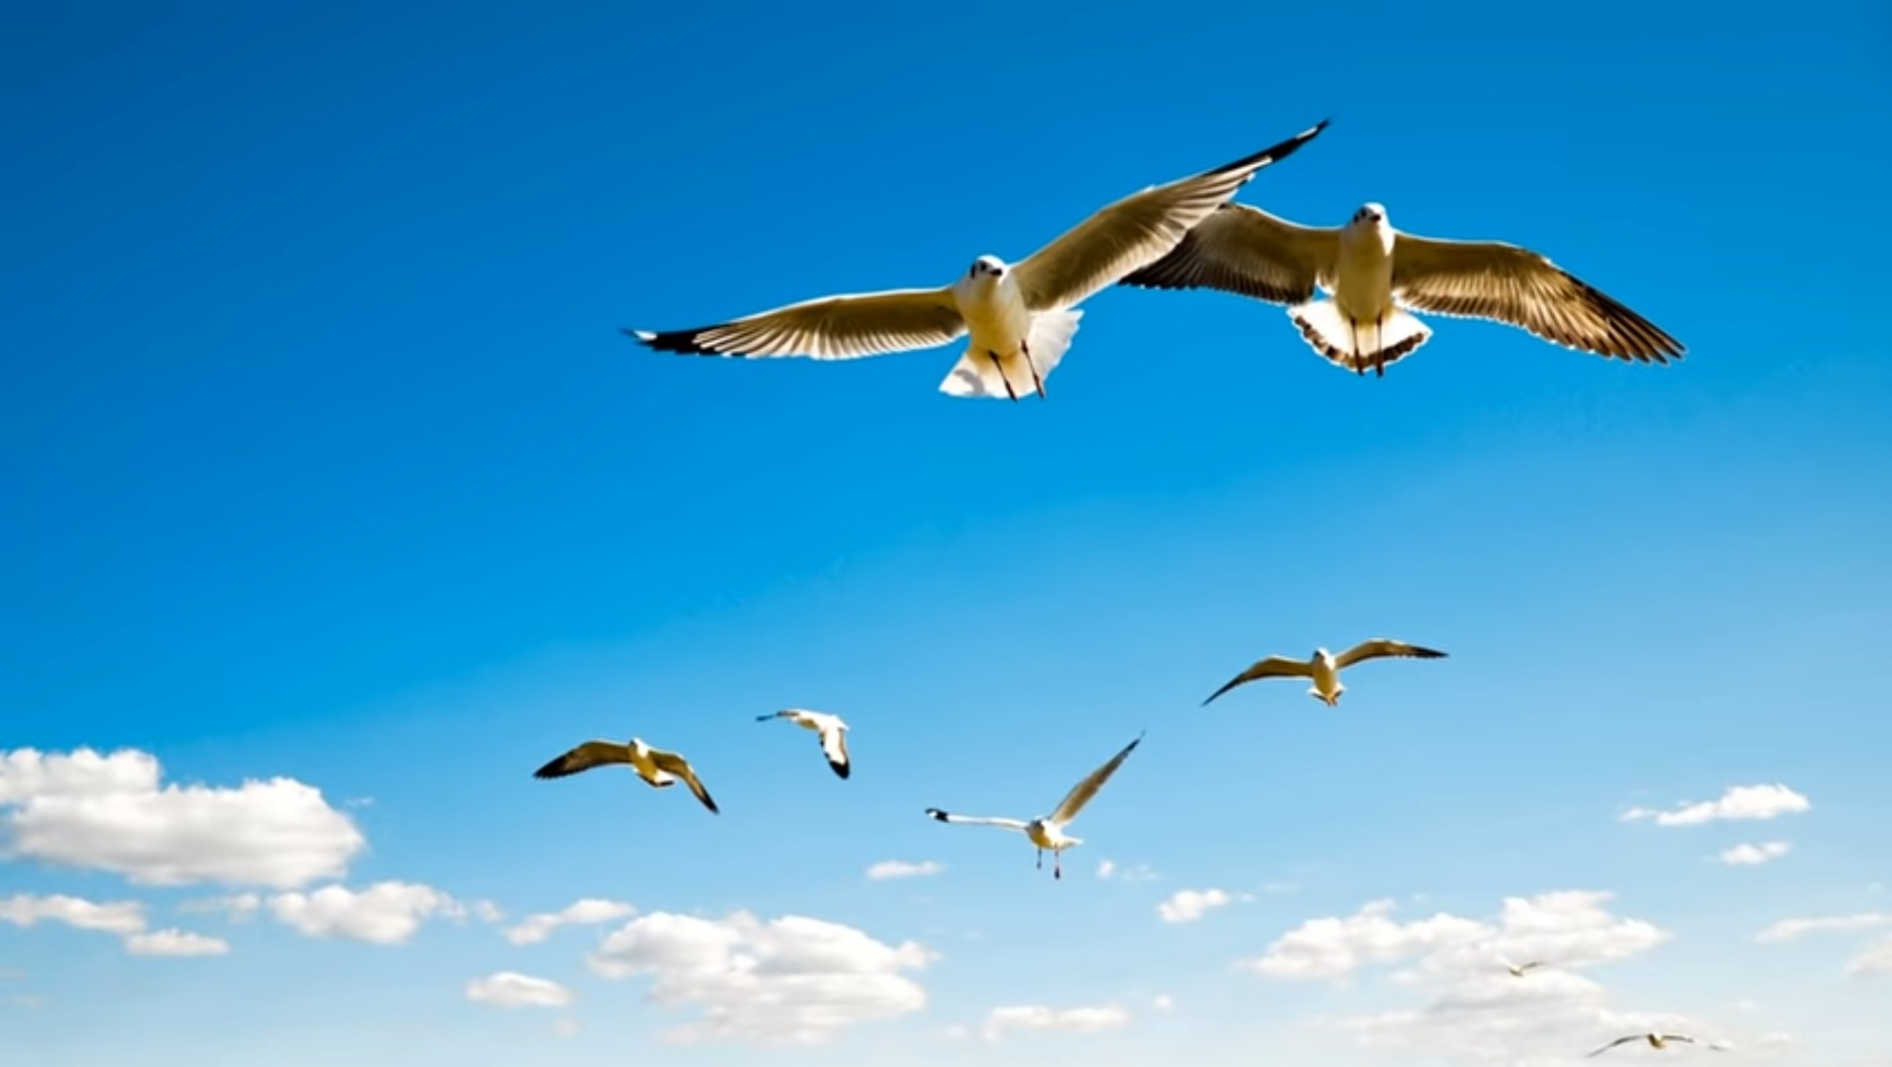
SUSTAINABLE DEVELOPMENT GOALS
16. PEACE, JUSTICE AND STRONG INSTITUTIONS

Slide 2
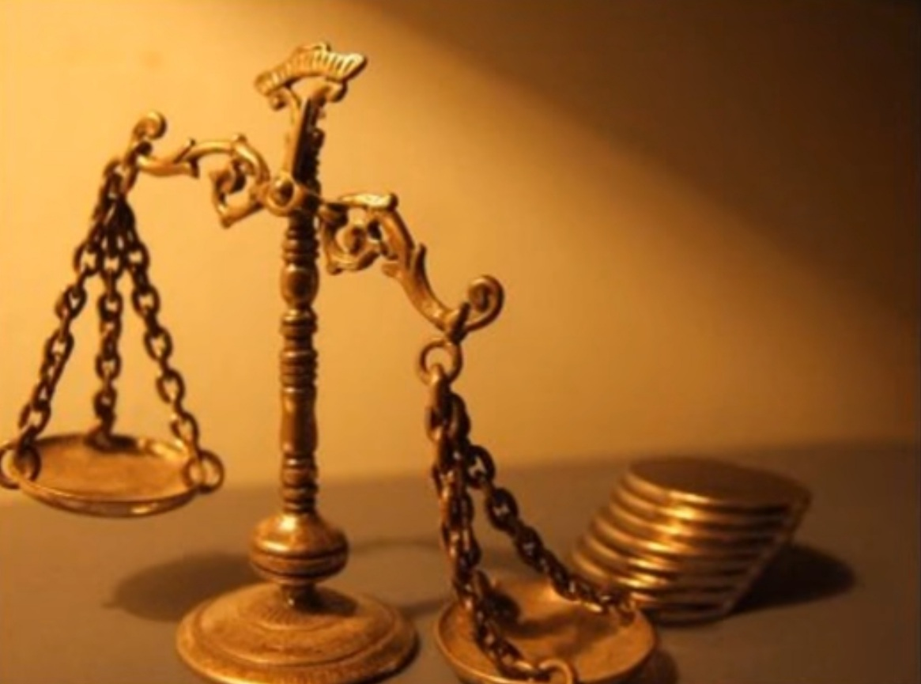
PEACE, JUSTICE AND STRONG INSTITUTIONS
Conflicts, insecurity, weak institutions, and limited access to justice continue to pose a serious threat to sustainable development.
The number of people fleeing wars, persecution and conflict exceeded 70 million in 2018, the highest number recorded by the Office of the United Nations High Commissioner for Refugees (UNHCR) in nearly 70 years.

Slide 3
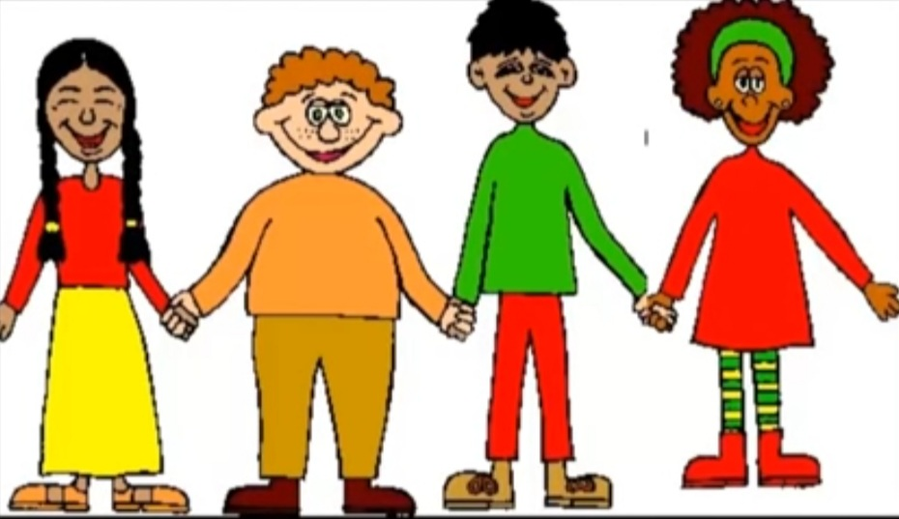
PEACE, JUSTICE AND STRONG INSTITUTIONS
In 2019, the United Nations recorded 357 murders and 30 enforced disappearances of human rights defenders, journalists, and trade unionists in 47 countries.
On the other hand, births of about one in four children worldwide under the age of 5 are never officially recorded, depriving them of proof of legal identity, which is crucial for the protection of their rights and for access to justice and social services.

Slide 4
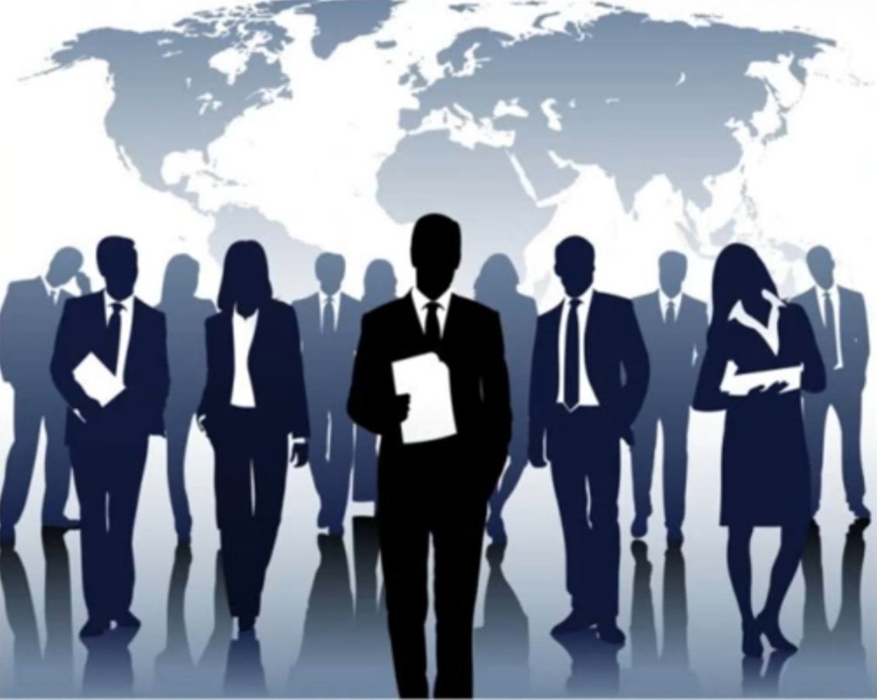
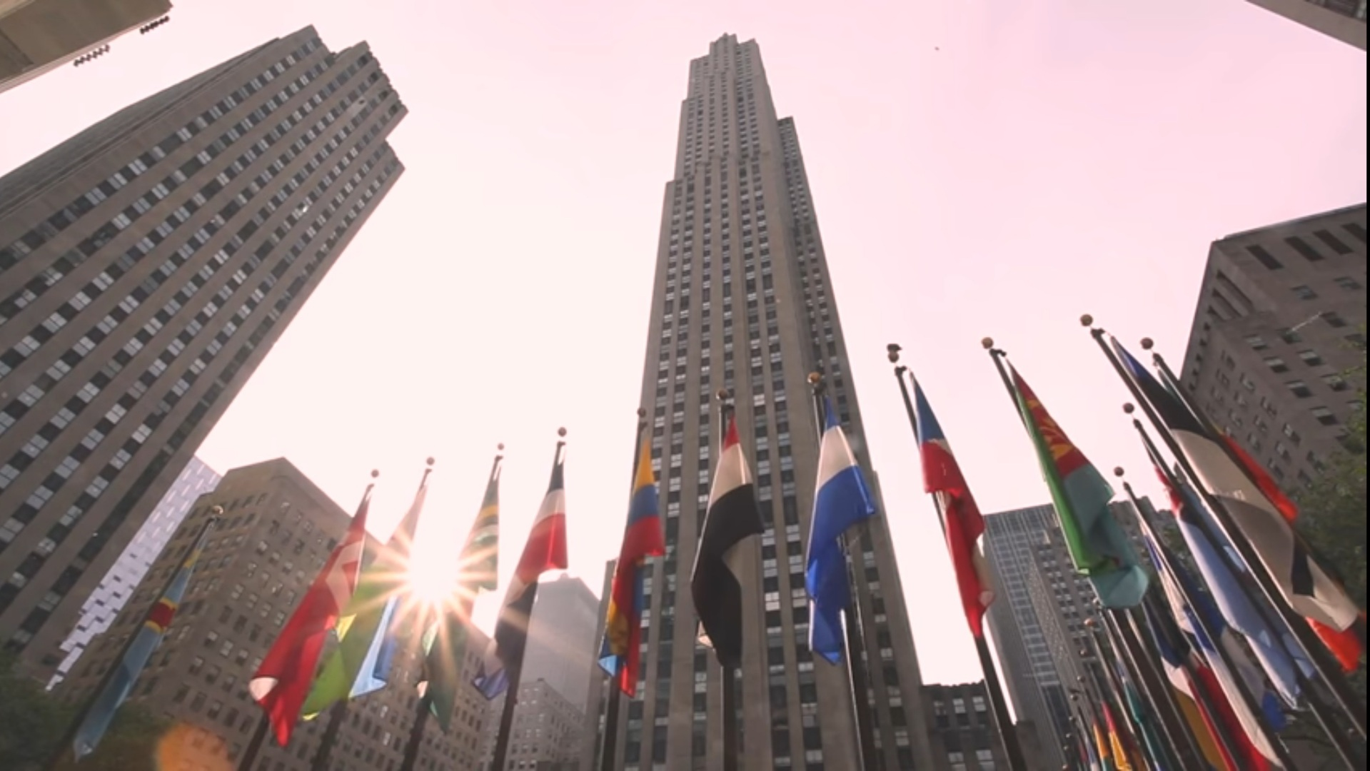
PEACE, JUSTICE AND STRONG INSTITUTIONS
What is the goal in this case?
Promoting peaceful societies inclusive for development facilitate access to sustainable justice for all and create effective, responsible institutions inclusive at all levels.

Slide 5
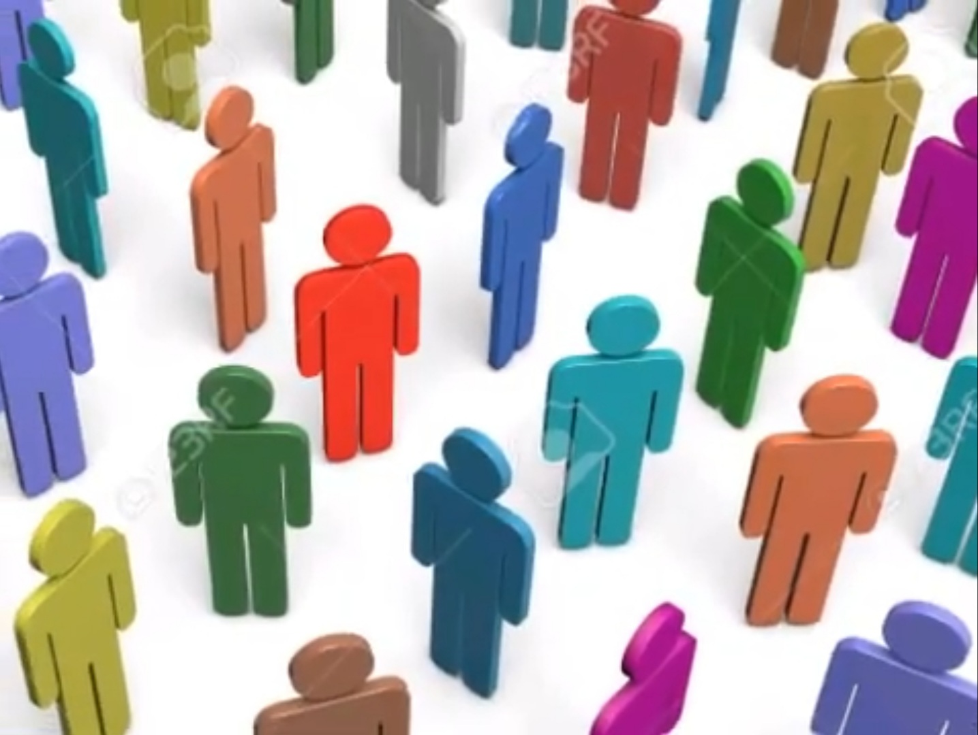
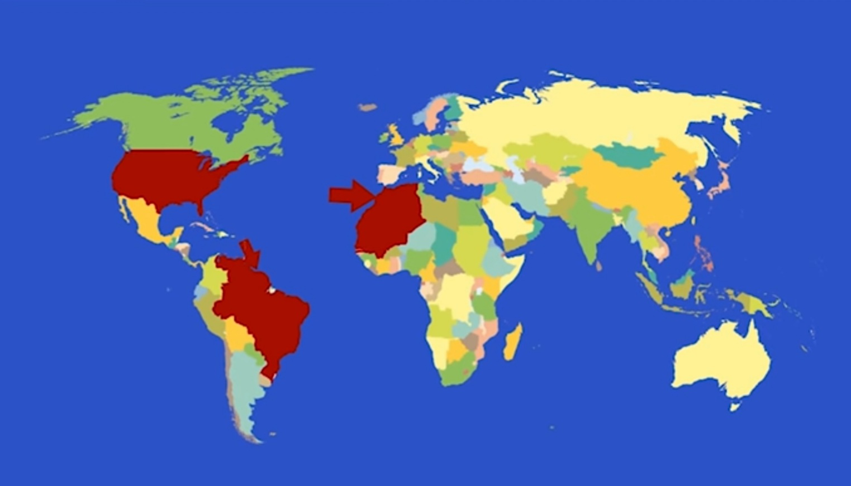
PEACE, JUSTICE AND STRONG INSTITUTIONS
What needs to be done to achieve it?
To achieve peace, justice and inclusion, it is important that governments, civil society and communities work together to implement lasting solutions that reduce violence, do justice, effectively fight corruption and ensure at all times inclusive participation.

Slide 6
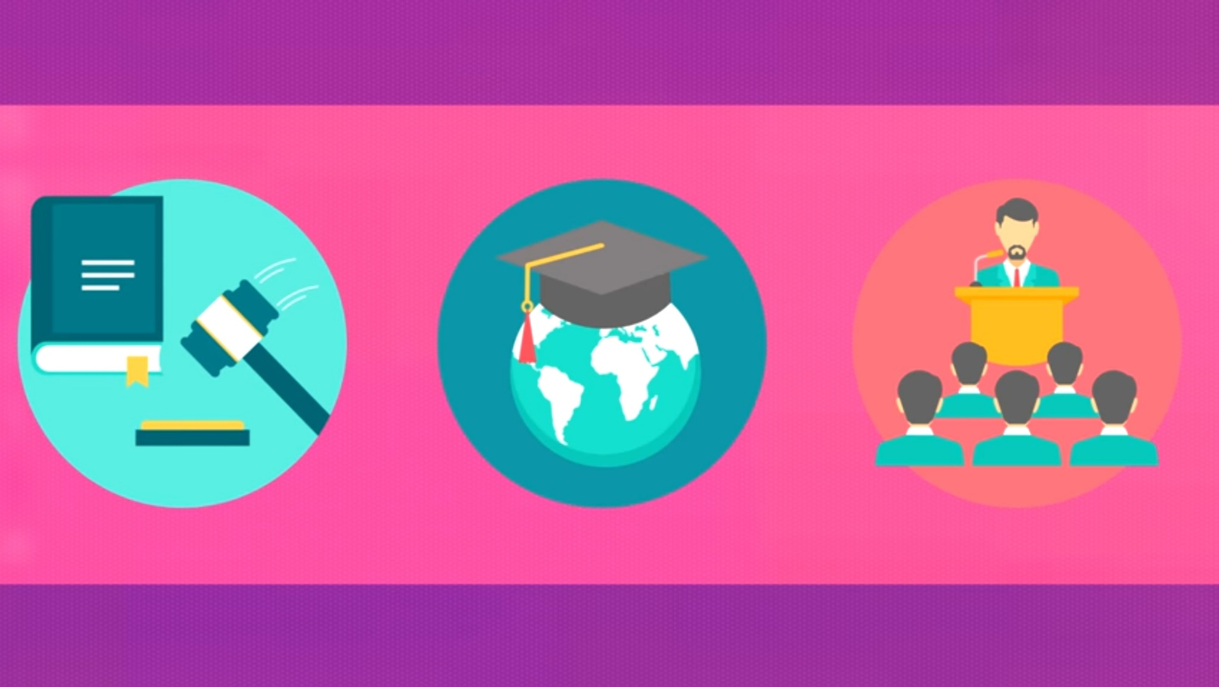
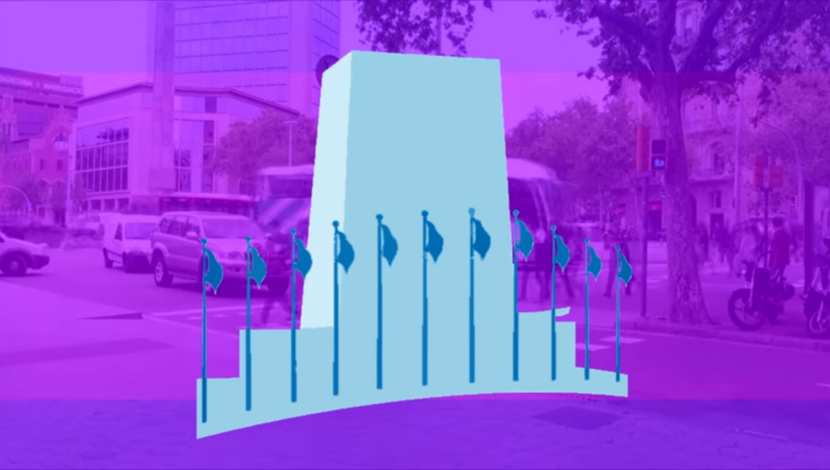
PEACE, JUSTICE AND STRONG INSTITUTIONS
What can we do?
Really interested in our government's action. Raising awareness of our own community about the reality of violence and the importance of building societies peaceful and fair and determine how we can contribute to the achievement of Sustainable Development Goals in our daily lives. Exercise our right to demand that elected officials be held accountable for your performance. Exercising our right to freedom of information and share our opinion with elected representatives. Boosting change – promoting inclusion and respect for people of different provenance, ethnicity, religion, gender, orientation sexual or opinion.

Slide 7
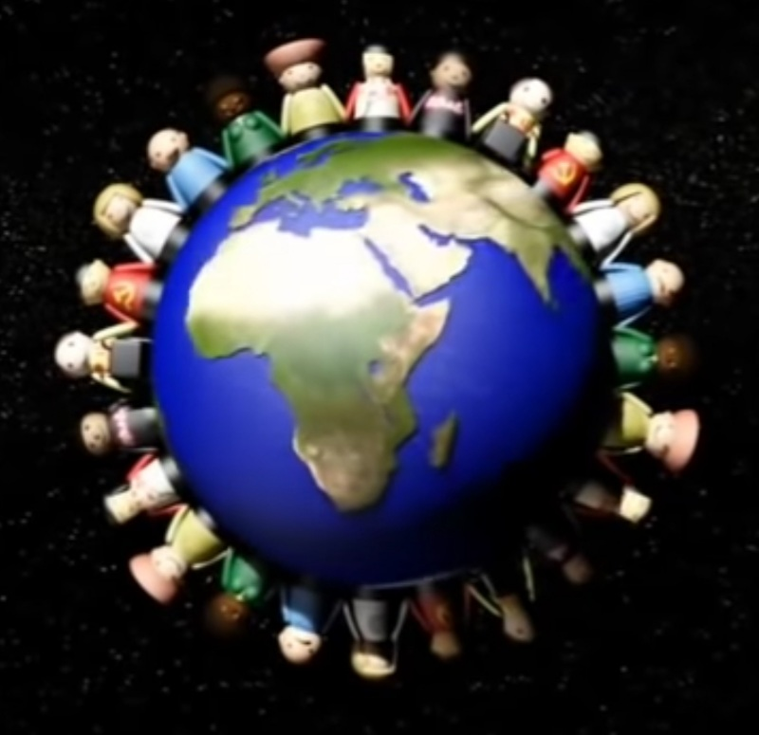
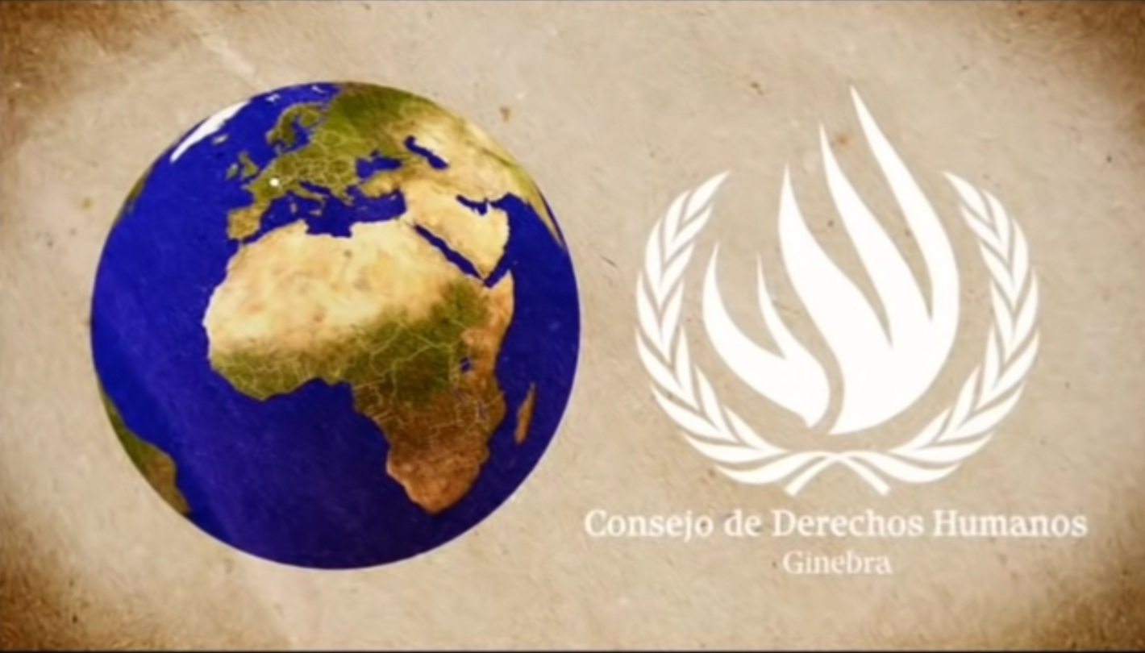
PEACE, JUSTICE AND STRONG INSTITUTIONS
ACTIVITY 1
What are the universal human rights? - Benedetta Berti
After watching Benedetta Berti's video, make a summary and critical reflection on the importance of human rights.
https://youtu.be/nDgIVseTkuE

Slide 8
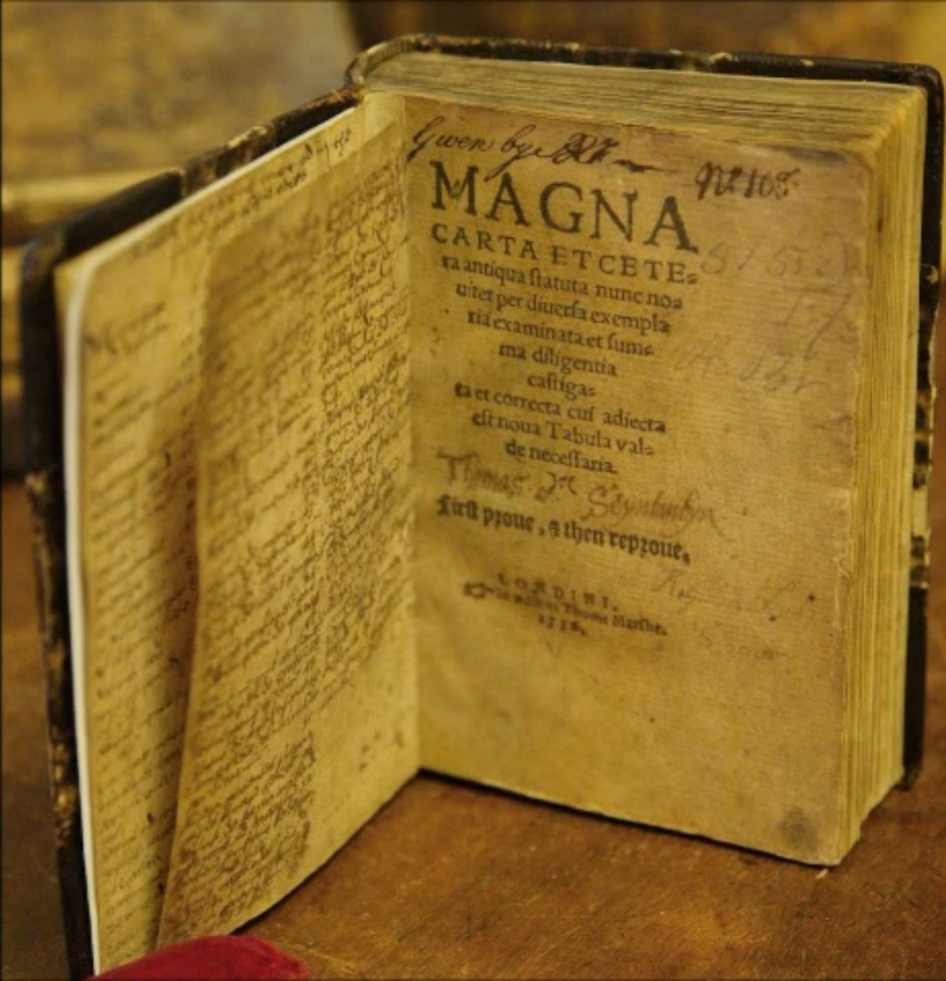
PEACE, JUSTICE AND STRONG INSTITUTIONS
ACTIVITY 2
The Story of Human Rights
https://youtu.be/6XXGF_V8_7M
After watching the video, answer the questions:
a) What are human rights and to whom do they correspond? How many are there in total?
b) Make a brief summary of the historical tour of your emergence, highlighting the following:
-Affirmations of Cyrus the Great.
-What is natural law?
-What does Magna Carta of 1215 say?
-The first liberal revolutions, the French revolution and the world wars.
c) What was the purpose of the United Nations?
d) What happened at first, when the Declaration was signed?
e) Where should we seek the meaning of these rights?

