Slide 1
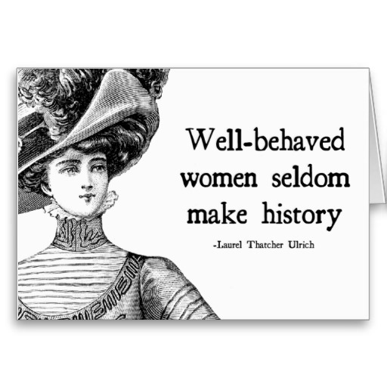

Women today
8th March

Slide 2
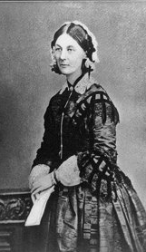
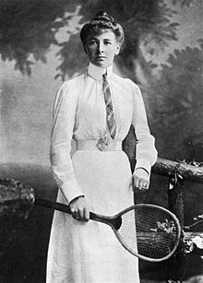
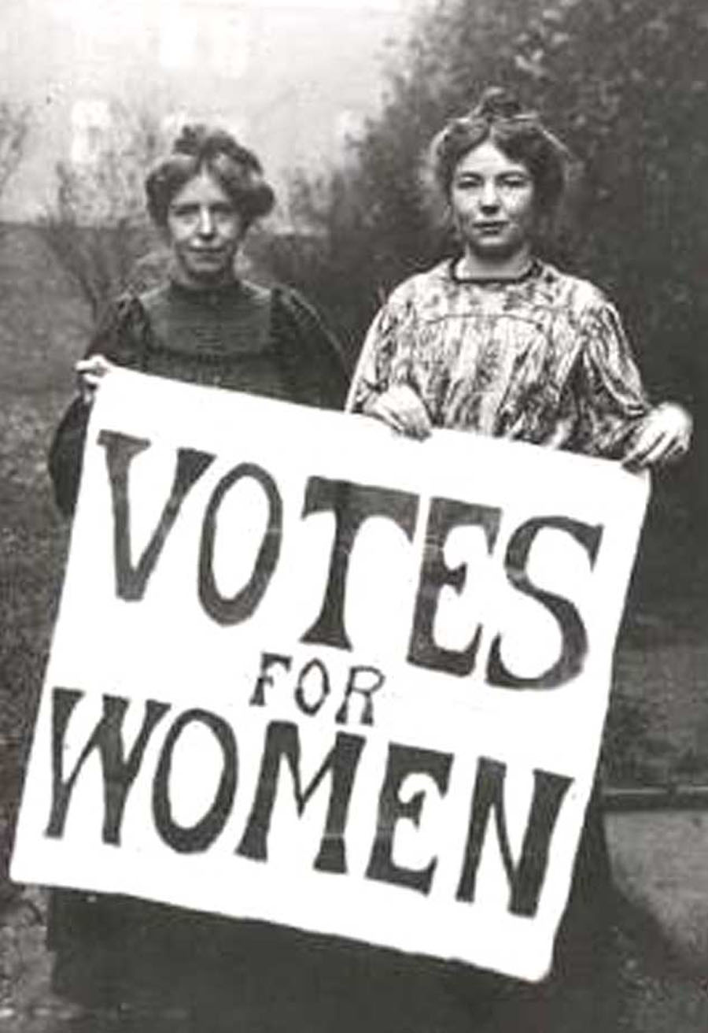
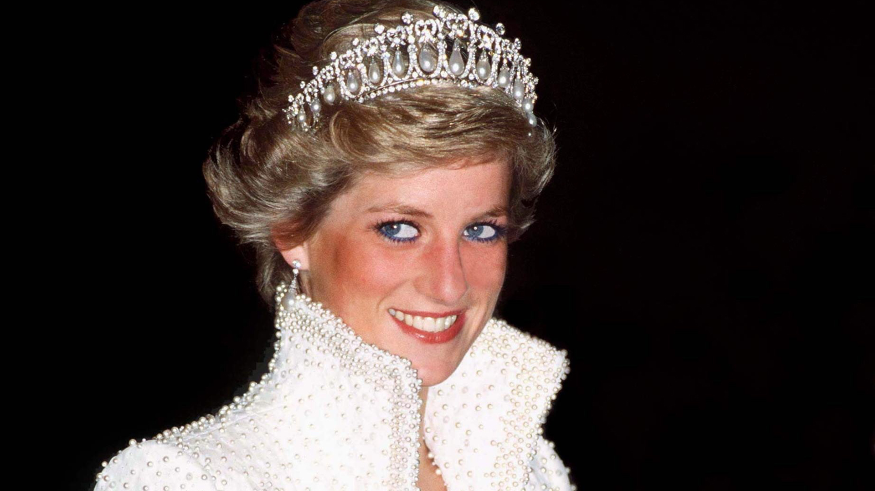
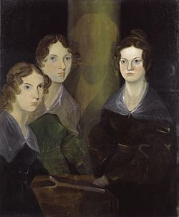
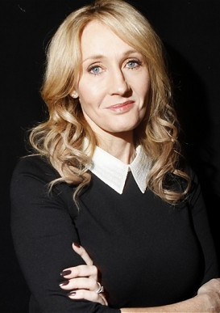
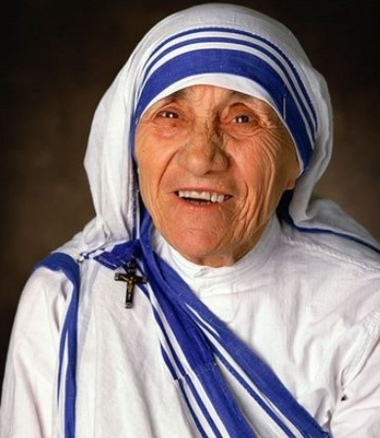
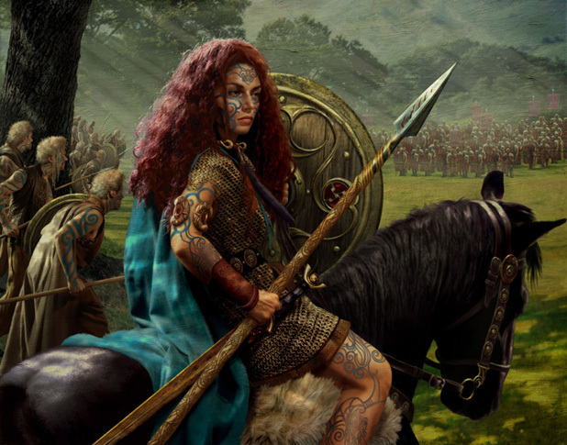
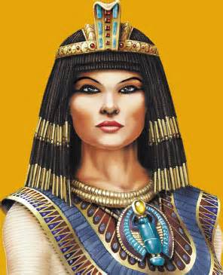
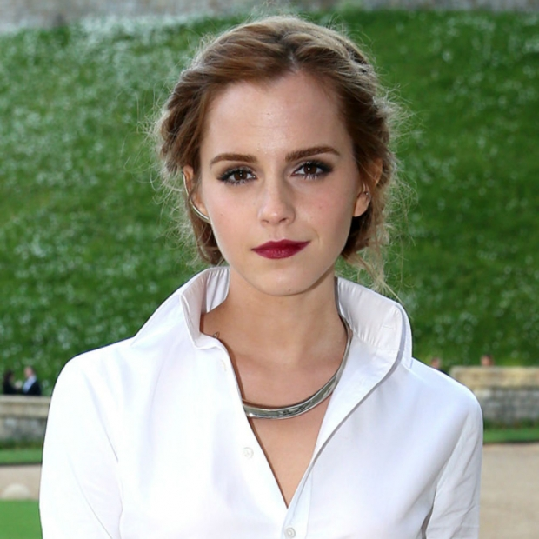
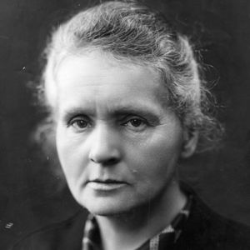
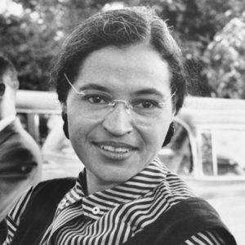
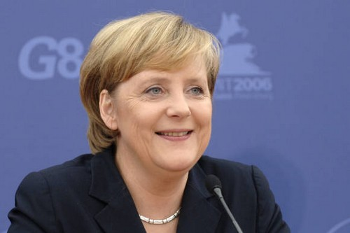
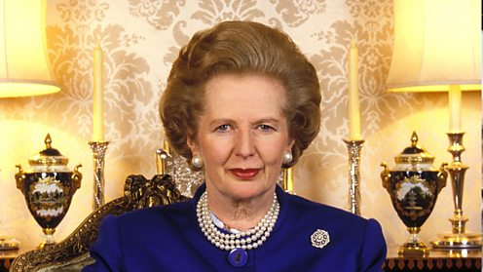
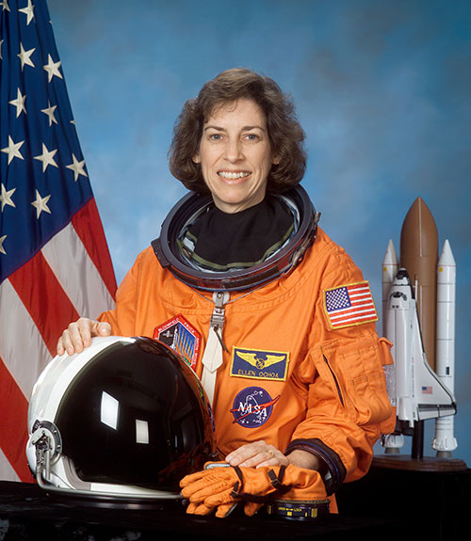

Slide 3
Important Women
Florence Nightingale – Nurse
Cleopatra – Ruler
Margaret Thatcher – First UK Female PM
Hélène de Pourtalès – First Female Olympic Champion
Emma Watson – Actress, Feminist and supporter of equal rights.
The Suffragettes – fought for the vote for women in the UK.
Marie Curie – Female Scientist
Ellen Ochoa – First Hispanic Female Astronaut.
Princess Diana – Stood up to British Royal Family
J K Rowling – Robert Galbraith?
Angela Merkel – German Chancellor
The Bronte Sisters (Bell)
Boudica – Queen of British Celtic Tribe who fought the Romans
Rosa Parks – stood up for Black Rights

Slide 4
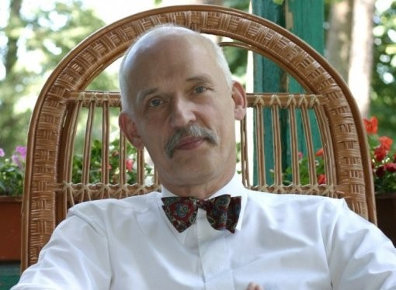

Slide 5
In what appears to be a quite poorly attended debate on gender pay gap in the European Parliament, a Polish MP called Janusz Korwin-Mikke exercised great powers of logic and argumentation to close the debate by saying that women are ‘smaller, less intelligent, and they must earn less, that’s all.’

Slide 6
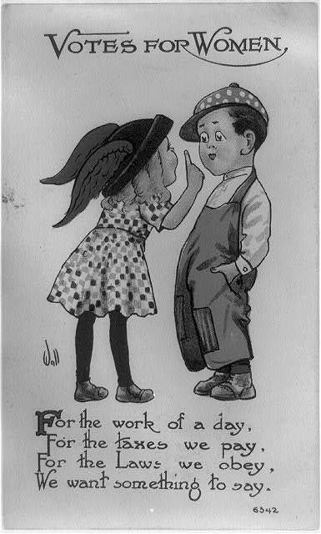
When did IWD begin?
On 19th March 1911, IWD was marked for the first time by over a million people in Europe.
March 8th
Pankhurst was instrumental in placing women in men’s jobs during World War 1 and campaigning for women’s rights.
It wasn’t until 1928 that women were finally given the same voting rights as men in the United Kingdom.

Slide 7
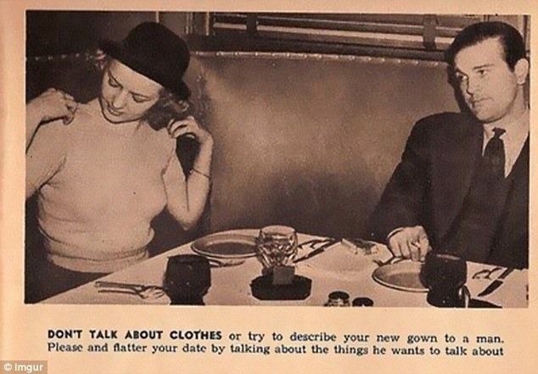
Old Fashioned Rules…
In the 18th Century, women could not talk to someone without being introduced.
In the UK/USA, it was not illegal for a man to rape his wife until 1991!!
Victorian Women couldn’t give a man a shop-bought gift.
A woman’s walk conveyed her character.
Single Women in the 1950s were told to avoid the appearance of evil.
Before 2012, a woman could not become Queen if there were males in line to the throne (in the UK and Spain!)

Slide 8
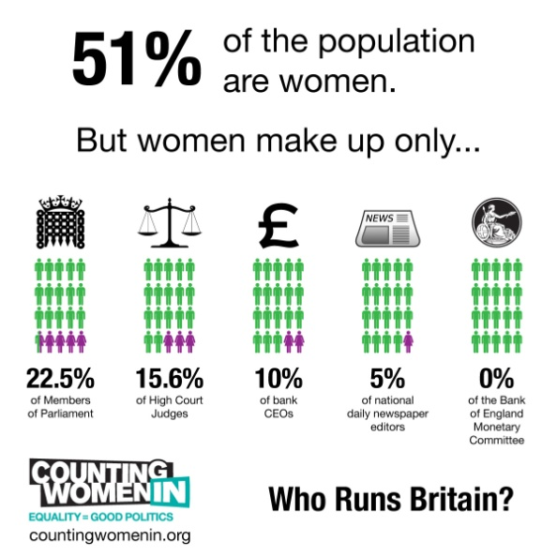
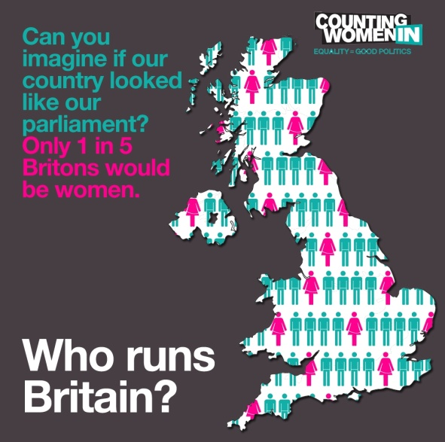
Women today
Still not equal.
The pay gap.
Women still less in some work areas.
72% of people believe that men and women are equal.
Women are penalised for having children.
Parliament is supposed to represent the people
Strike

Slide 9

Key areas we still need to change
Catholic Priests
Marriage
Women can’ straddle motorbikes in Indonesia
The UK, Turkey and Slovakia still ban women from fighting on the front line.
In the USA it is difficult for women to get access to birth control cheaply and easily.
Men’s Sports have much more coverage than Women’s.
There are still few female artists.

Slide 10
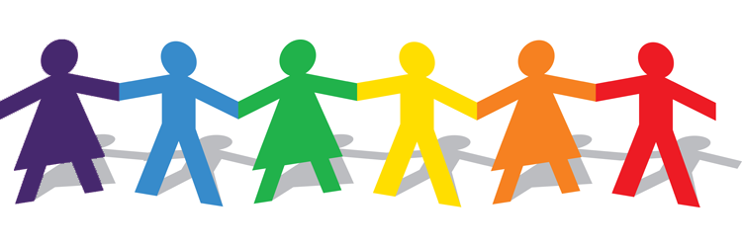
Over to you…

