Slide 1
FRANKENSTEIN
ANALYSIS OF THE MONSTER
Estela and Marina García Pintos 2ºBach B

Slide 2
WHAT IS HE?
The monster is an invention of the main character, Victor Frankenstein. He is gigantic (2'5 metres tall).
He is a hideously ugly creation, with translucent yellowish skin pulled so taut over the body that it ‘barely disguised the workings of the arteries and muscles underneath;’ He has watery, glowing eyes, flowing black hair, black lips and prominent white teeth.
As depicted by Shelley, the monster is a sensitive, emotional creature whose only aim is to share his life with another being like himself.

Slide 3
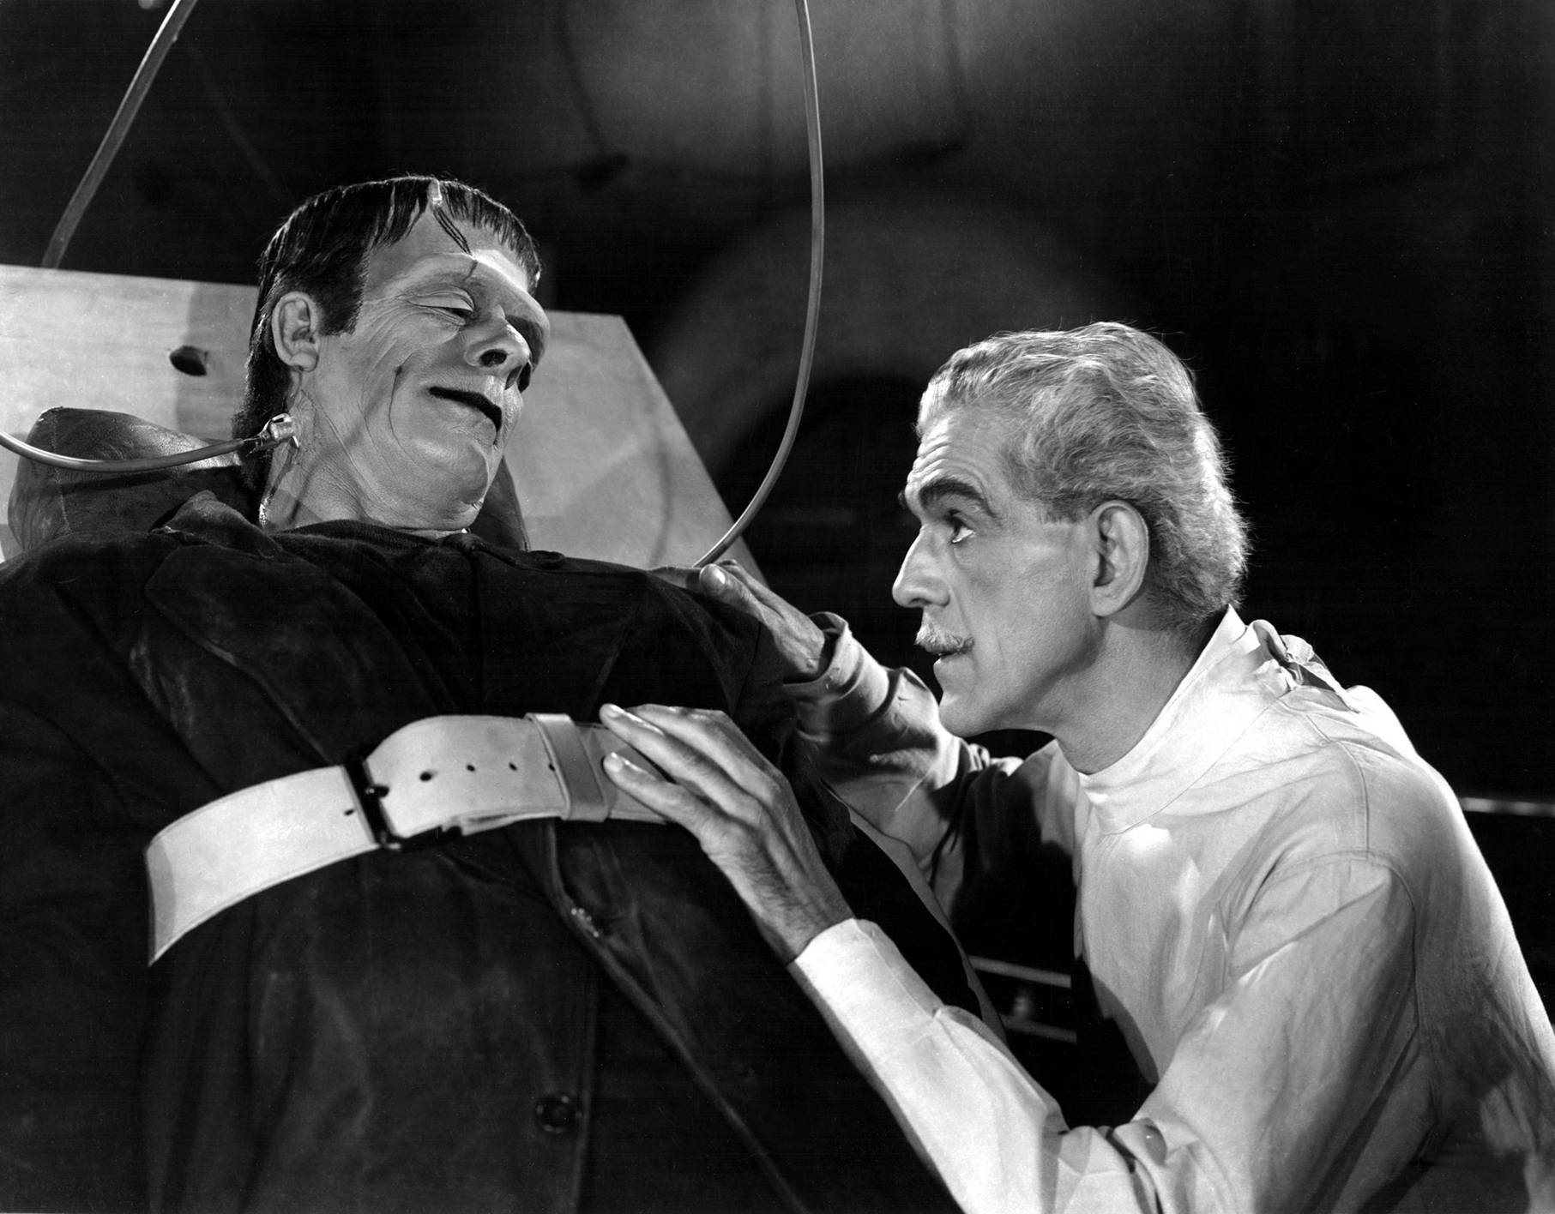

Slide 4
HOW DOES HE FEEL?
At the beginning, he was scared of people because they all yelled at him and he couldn't trust anyone.
He meets the Delacey family and he feels even more alone. They are a really close family and he is jealous of them and the life they have. Felix, the son, has a girlfriend called Safie. She was from Arabia and they taught her their language. The monster learnt it too and for the first time he is happy that he can make friends.

Slide 5
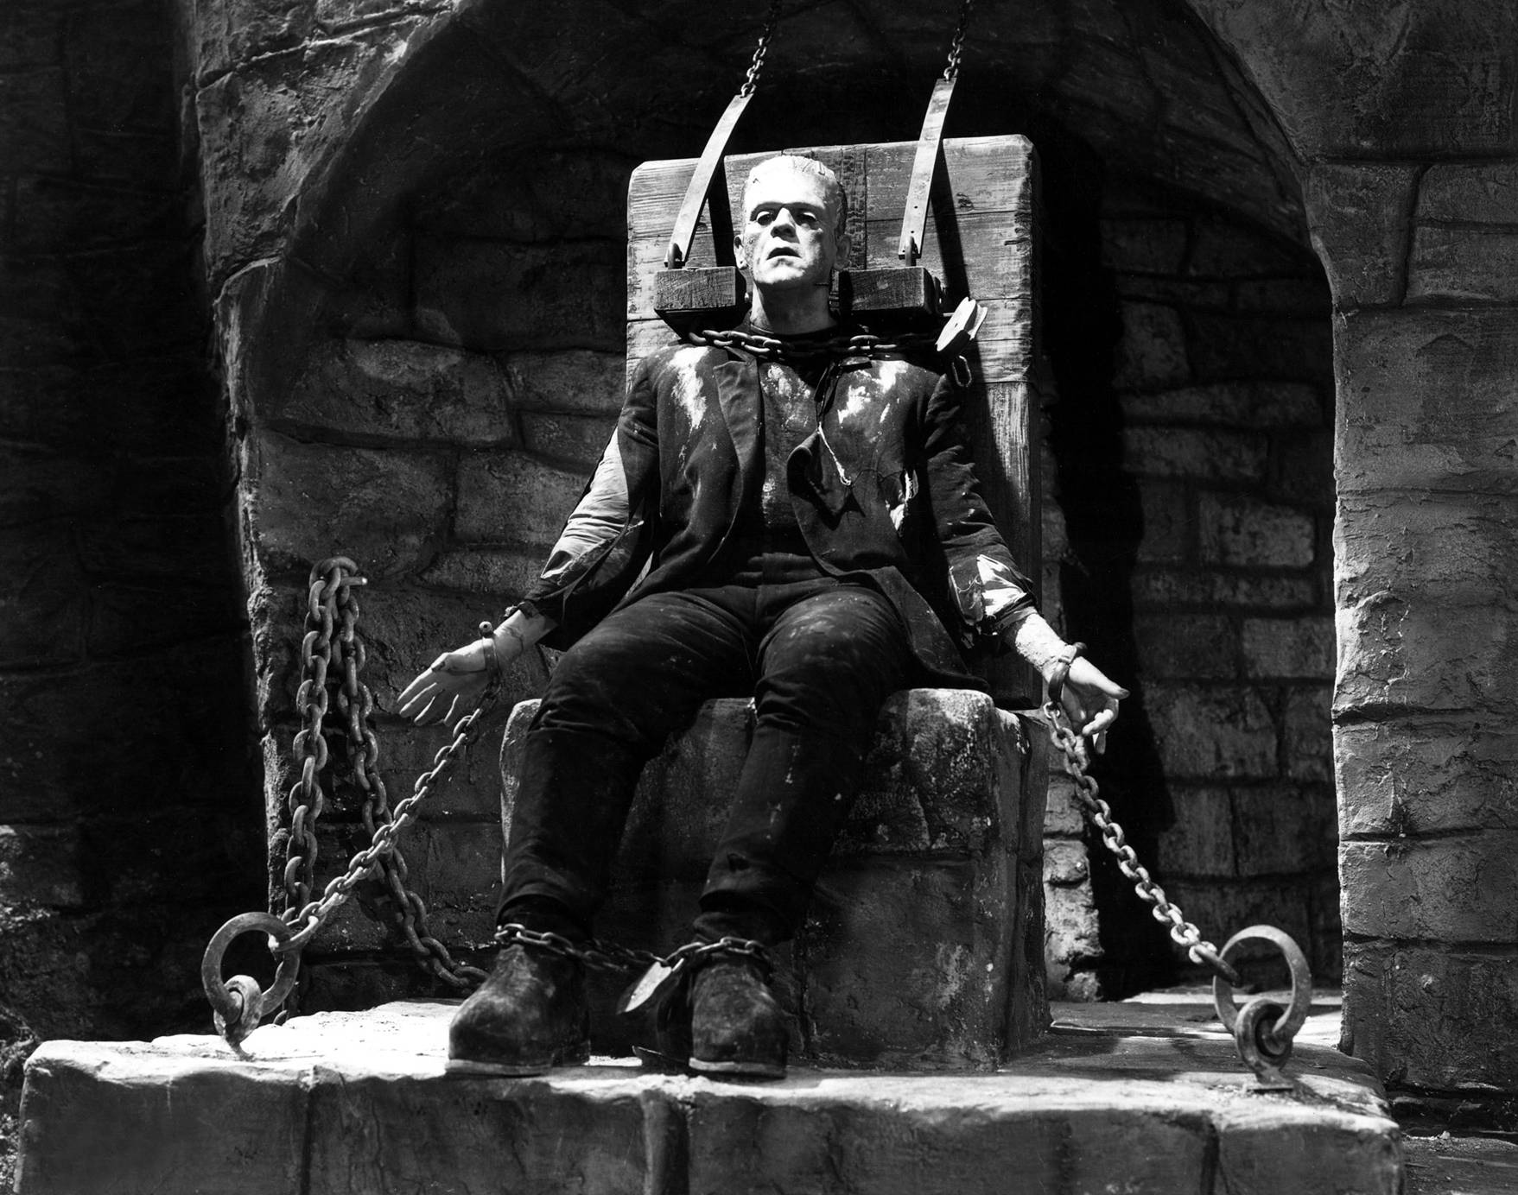

Slide 6
In the middle of the story, he finds Victor and asks him if he could make a girlfriend for him. Victor accepts but then he betrays the monster destroying the body of the new creature. At that moment, the monster vows to take revenge on Frankenstein (specifically his family and his future wife Elizabeth, although Frankenstein doesn’t realise this at the time).
At the end, when the monster has completed his revenge, killing Elizabeth, he is satisfied that Victor feels as alone as he does.

Slide 7
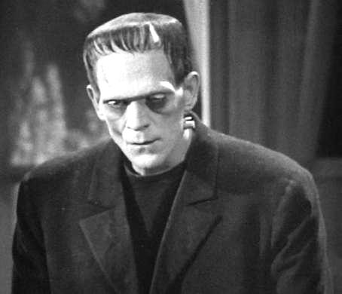
When the Monster is on Robert Walton's boat, and he kills Victor, he feels miserable despite the fact that Frankenstein has rejected him since he was created.

Slide 8
DO YOU FEEL SORRY FOR THE MONSTER?
We feel sorry for the monster because he was created against his will and he is so ugly that nobody wants to get close to him. All he wanted was a girlfriend and Victor betrayed him leaving him alone forever.

Slide 9
IS FRANKENSTEIN RIGHT TO TREAT THE MONSTER HOW HE DOES?
No, the Monster doesn't deserve to be treated how he is because he was created out of Victor's selfish desire and it isn’t his fault that he is ugly.
Frankenstein should have taken charge of his own creation, like a Father to his child.

Slide 10
TRULY EVIL OR TURNED THAT WAY?
We think that he was eventually turned evil because of the attitude of the people around him.
If he had had someone by his side that would have accepted him for how he was, he probably wouldn’t have turned into an evil monster.

Slide 11
