Slide 1

Valentine´s Day
Roses are red, violets are blue, I just want you to know, I think the world of you.

Slide 2
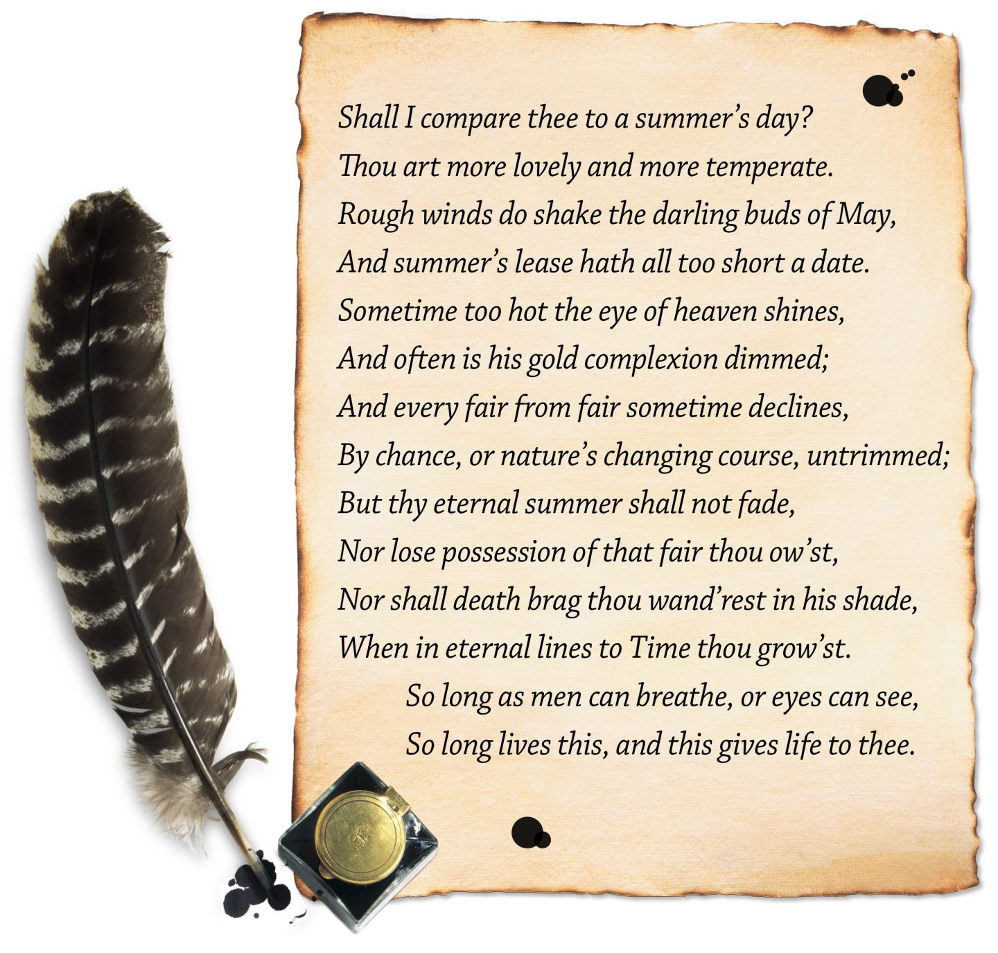

Shakespeare´s Sonnet 116
How to write a sonnet

Slide 3
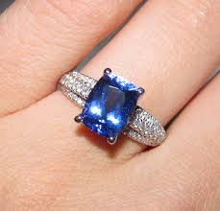

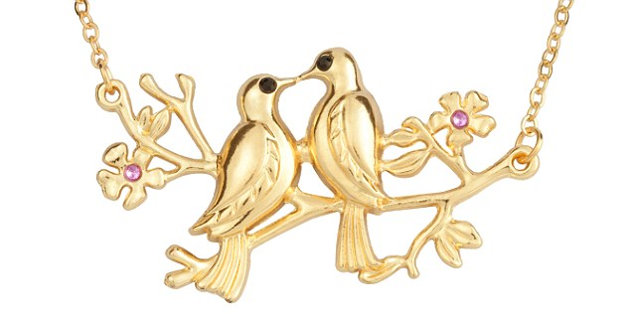

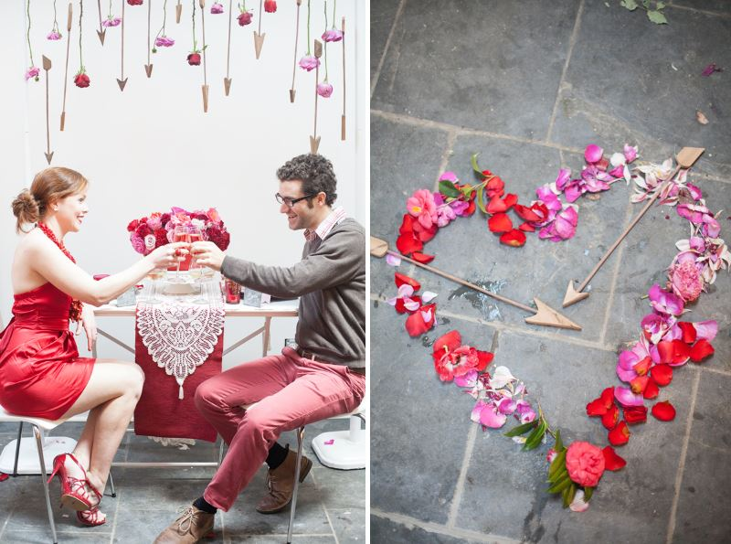
How is Valentine´s day celebrated?
???

Slide 4
Sonnets and Valentine’s day?
Sonnet’s were the original love poem!
Sonnetto is Italian for ‘little song’
Originating in Italy, the sonnet was established by Petrarch in the 14th century as a major form of love poetry, and came to be adopted in Spain, France and England in the 16th century, and in Germany in the 17th.

Slide 5
Sonnet 116 William Shakespeare
Let me not to the marriage of true minds
Admit impediments. Love is not love
Which alters when it alteration finds,
Or bends with the remover to remove.
O no! it is an ever-fixed mark
That looks on tempests and is never shaken; It is the star to every wand'ring bark, Whose worth's unknown, although his height be taken. Love's not Time's fool, though rosy lips and cheeks Within his bending sickle's compass come; Love alters not with his brief hours and weeks, But bears it out even to the edge of doom. If this be error and upon me prov'd, I never writ, nor no man ever lov'd.

Slide 6
Sonnet 116 William Shakespeare
Let me not to the marriage of true minds
Admit impediments. Love is not love
Which alters when it alteration finds,
Or bends with the remover to remove.
O no! it is an ever-fixed mark
That looks on tempests and is never shaken; It is the star to every wand'ring bark, Whose worth's unknown, although his height be taken. Love's not Time's fool, though rosy lips and cheeks Within his bending sickle's compass come; Love alters not with his brief hours and weeks, But bears it out even to the edge of doom. If this be error and upon me prov'd, I never writ, nor no man ever lov'd.

Slide 7
How to write a sonnet
This form is a Shakespearean Sonnet:
14 lines
ABAB CDCD EFEF GG
So three stanzas, each four lines, with a rhyming couplet at the end.
Iambic Pentameter – 10 syllables per line, stressed, unstressed.

Slide 8
Stressed syllables
´My chest of books divide amongst my friends.´
There may be a “turn” where the poet changes his thought or turns in another direction.
Most sonnets turn, or shift in tone or focus, after the 1st eight lines—a surprise may occur in the couplet

Slide 9
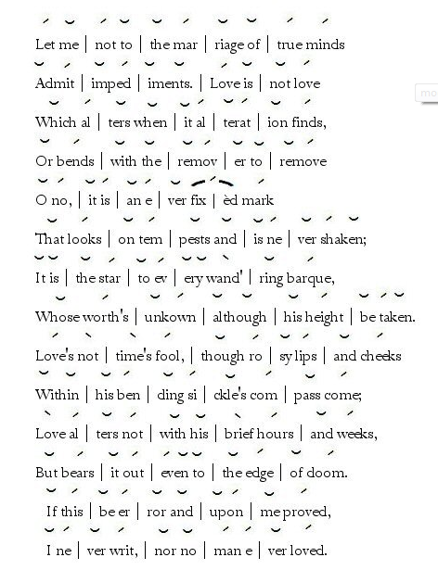

Slide 10
Can you translate sonnet 116?
Let me not to the marriage of true minds
Admit impediments. Love is not love
Which alters when it alteration finds,
Or bends with the remover to remove.
O no! it is an ever-fixed mark
That looks on tempests and is never shaken; It is the star to every wand'ring bark, Whose worth's unknown, although his height be taken. Love's not Time's fool, though rosy lips and cheeks Within his bending sickle's compass come; Love alters not with his brief hours and weeks, But bears it out even to the edge of doom. If this be error and upon me prov'd, I never writ, nor no man ever lov'd.

Slide 11
Soneto 116
İQué a matrimonio de alma y alma verdadera no haya impedimentos! No es amor amor que al encontrar alteraciones él se altera o se agacha a cavar con e demoledor. Oh no, él es hito fijo que por siempre dura mirando a la borrasca que a sus pies su estrella; es para todo errante barca la alta estrella, cuyo valor se ignora, aunque toméis la altura. No es juguete del Tiempo amor: si labios granas caen dentro del campás y siega de su aguja, Amor no muda con sus horas y semanas, sino hasta el borde del abismo aguanta y puja. Si todo esto es error y contra mí probado, yo nunca he escrito, y nunca ningún hombre amado

