Slide 1
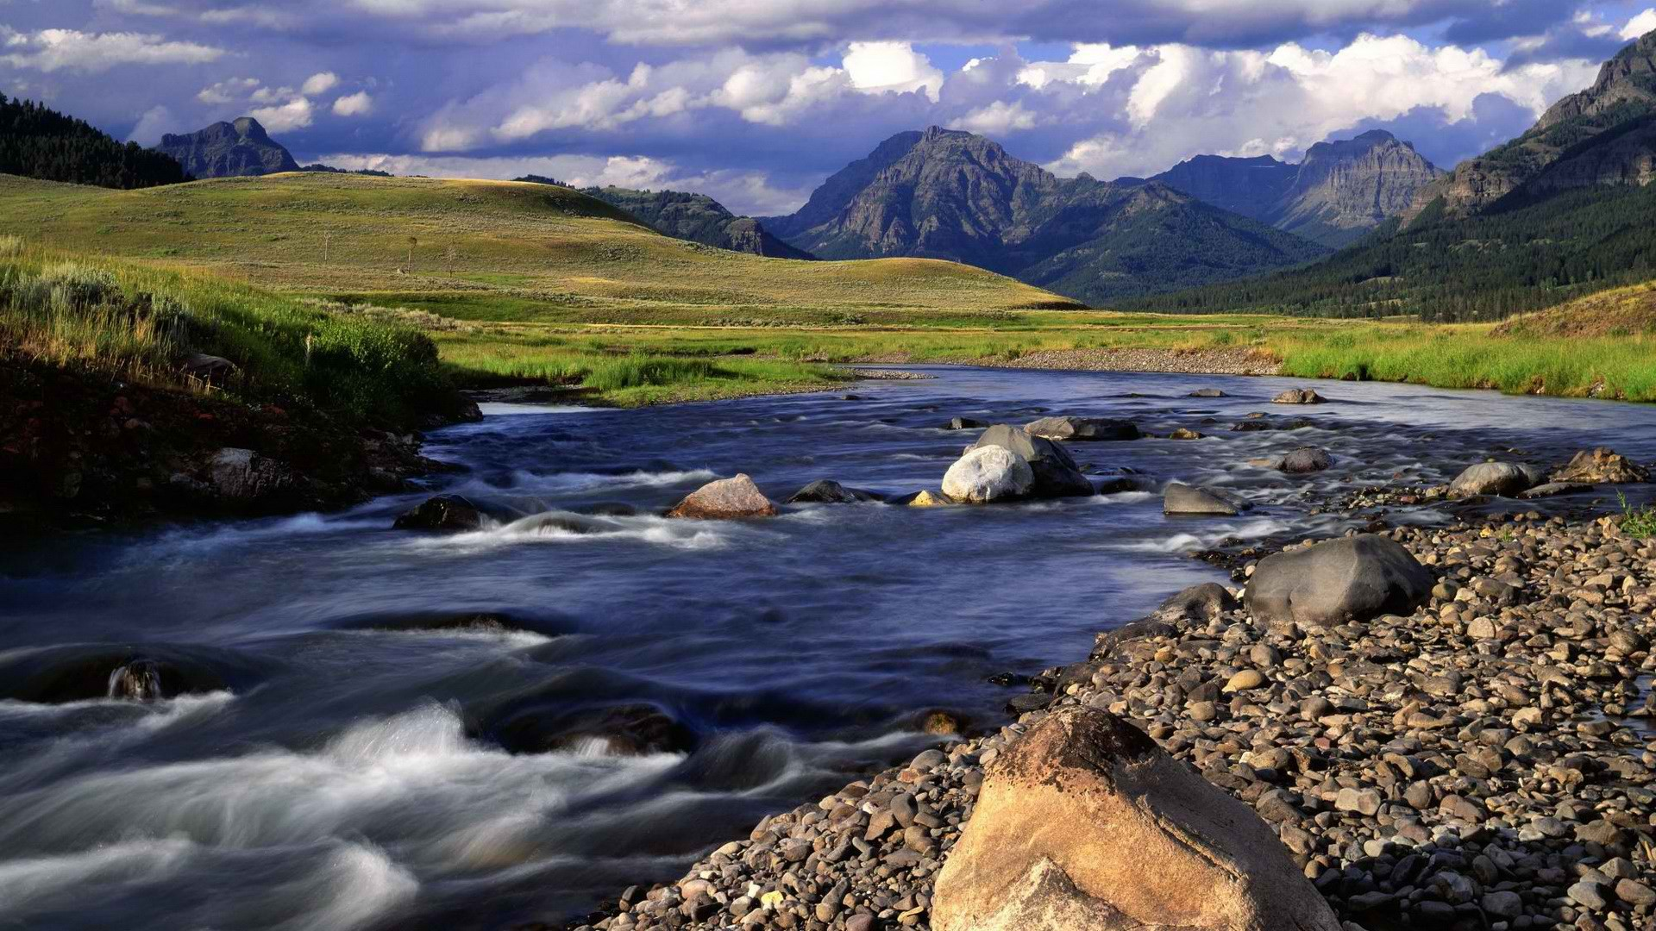
Yellowstone National Park
United States
https://www.youtube.com/watch?v=ysa5OBhXz-Q

Slide 2
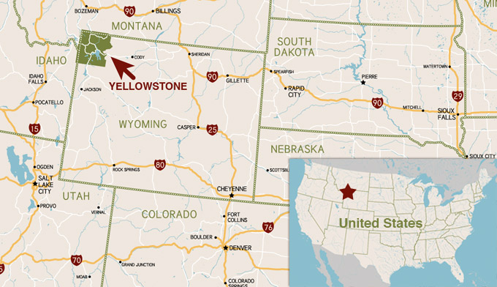
Where is Yellowstone National Park?

Slide 3
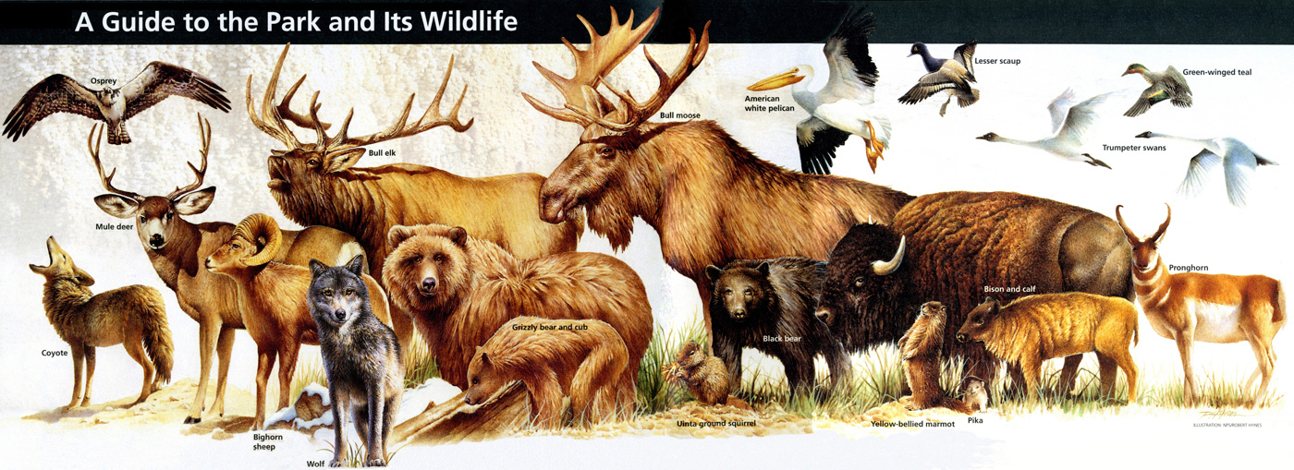
Animals!

Slide 4
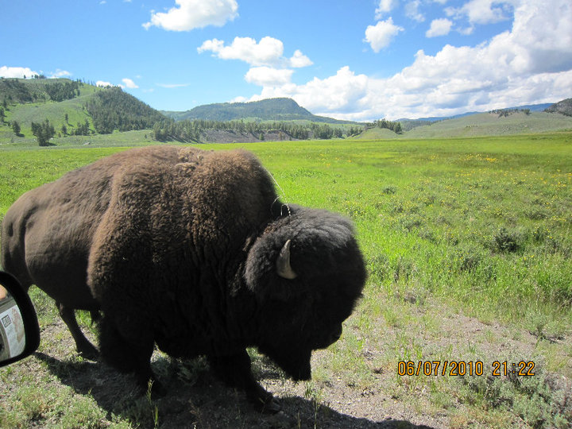
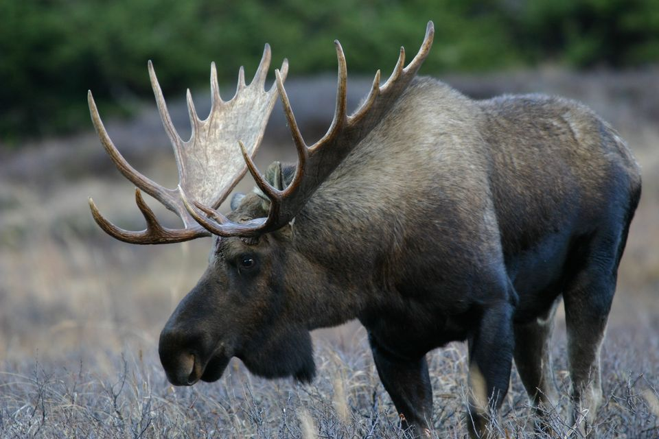
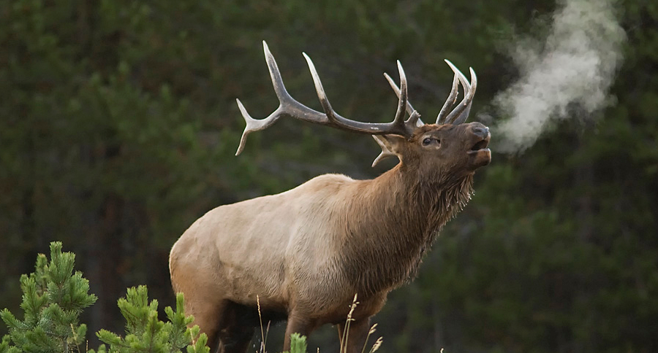
Animals in Yellowstone
- Bears - Elk - Wolves - Buffalo - Rabbits - Eagles - Horses - Fish - Moose

Slide 5
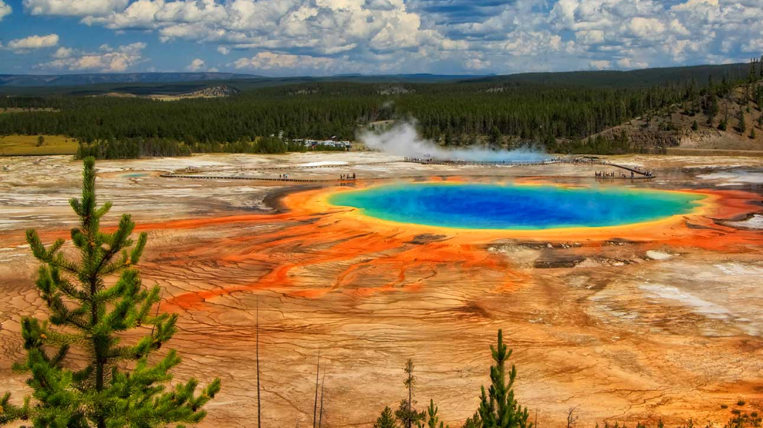
Quick Facts:
8,983 km²
The world’s first national park! 1st March 1872.
Yellowstone National Park is made up of lakes, geysers, canyons, rivers, and mountain ranges.
It spans three States- Wyoming, Montana and Idaho!
Yellowstone is actually a super volcano!
Yellowstone National Park has 50 mammal species, 311 bird species, 18 fish species, 6 reptile species, 4 amphibian species, and 5 endangered or threatened species.
Approximately 5% of the park is covered by water; 15% is grassland, and 80% is forest.

Slide 6
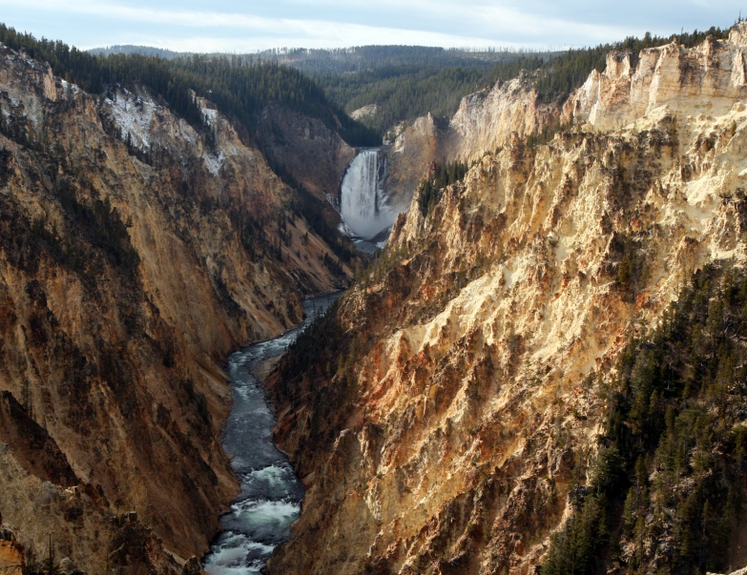
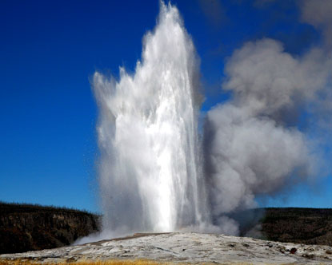
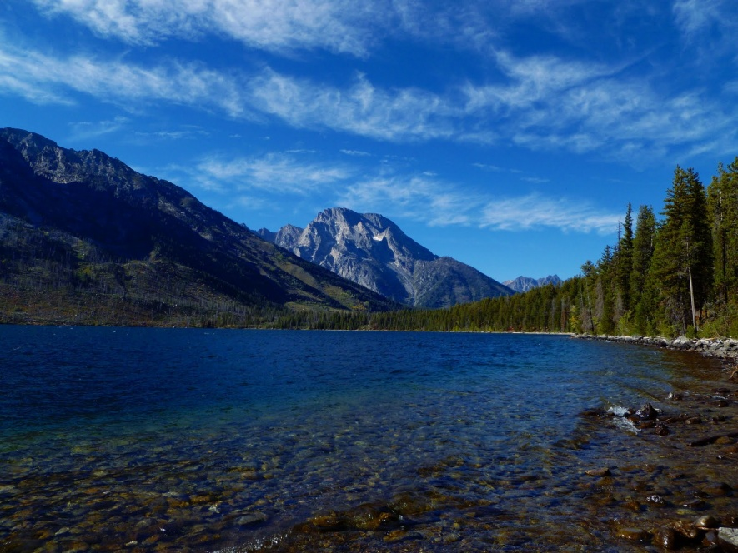
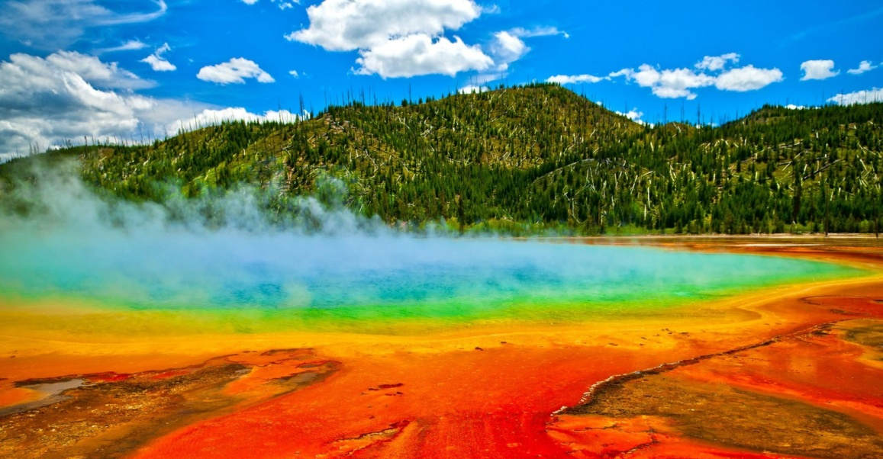
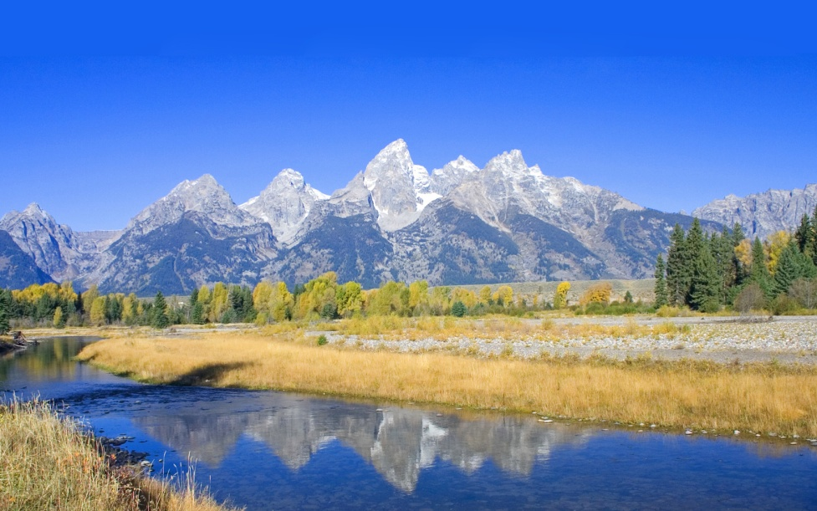
Geography
Lakes
Geysers
Canyons
Rivers
Mountain ranges.

Slide 7
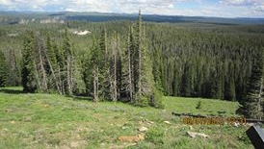
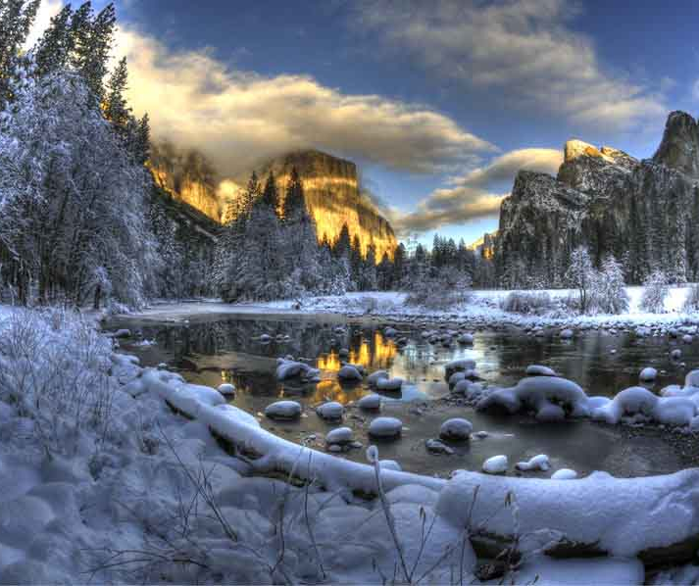
Summer / Winter
In Summer, the park can reach 27°C
In Winter, it is very cold! Normal day temperatures are between -6 °C and - 18 °C!!
There are lots of mountains in the park. The weather is worse at the top of the mountains. There is even snow in Summer!

Slide 8
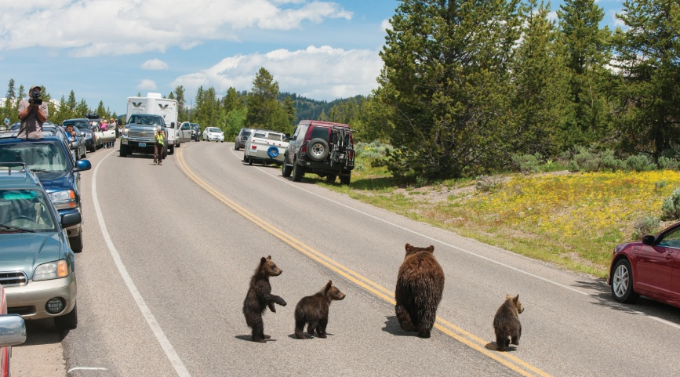
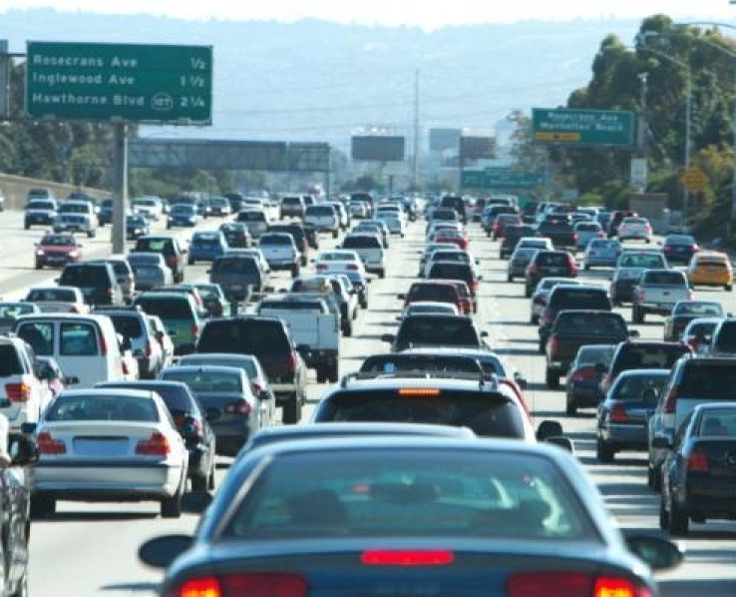
Bear Jam!
Traffic jams but with bears!

Slide 9
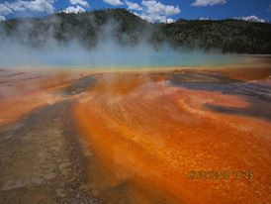
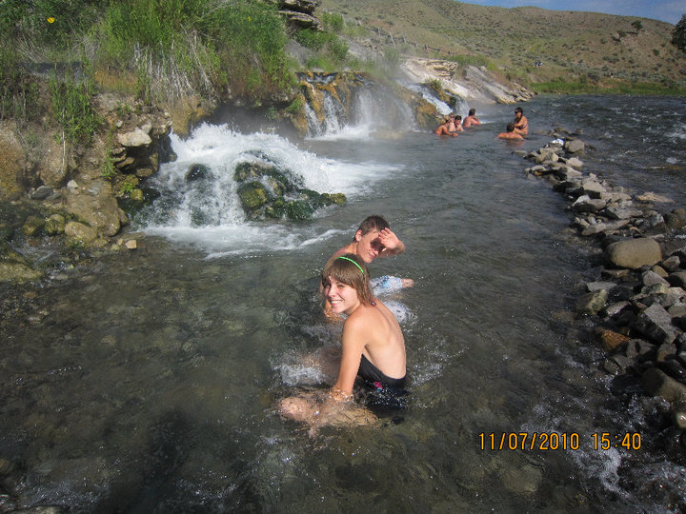
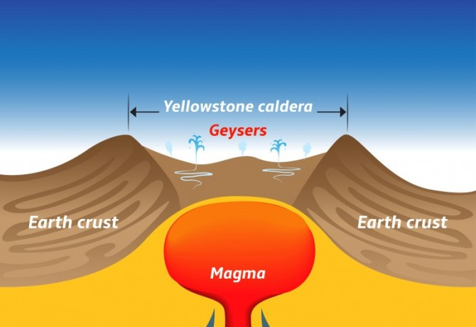
Geysers and Hot springs
Some hot springs are vividly coloured orange, red or yellow. This colouring is caused by colonies of microbes called archaea that can survive intense heat.
Geysers can erupt to 330 or more. Old Faithful in Wyoming can reach up to 130 feet.

Slide 10
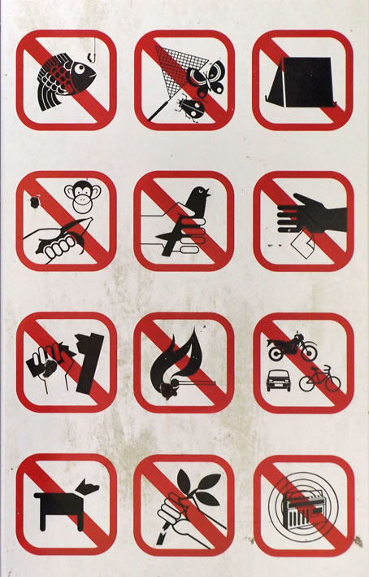
Draw a poster
What can we do to help protect National Parks?
Where should we put our rubbish?
What shouldn’t we stand on?
What should we do?
Where should we walk?
How can we protect animals?

