Slide 1
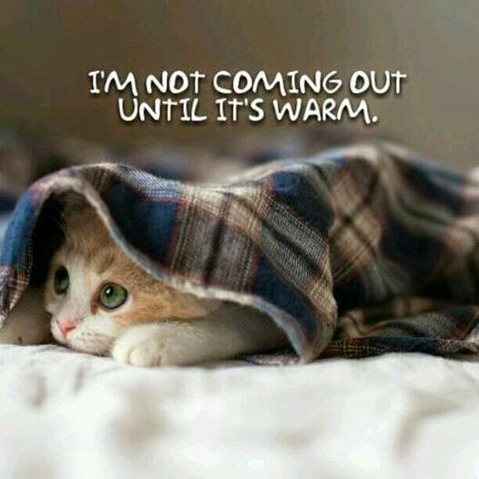
Weather
What kinds of weather are there?

Slide 2
It is sunny

Slide 3
It is windy

Slide 4
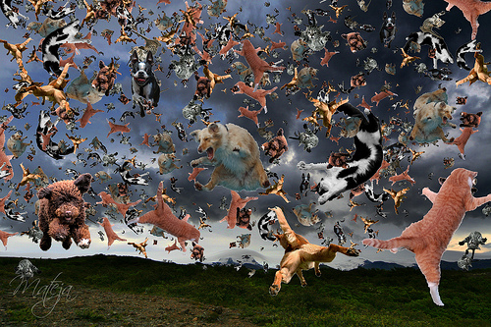
It is raining
It’s raining cats and dogs!

Slide 5
It is snowing

Slide 6
It is icy

Slide 7
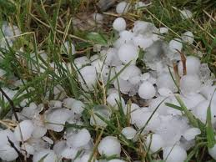
It is hailstoning

Slide 8
It is stormy and there is thunder and lightning

Slide 9
It is cloudy

Slide 10
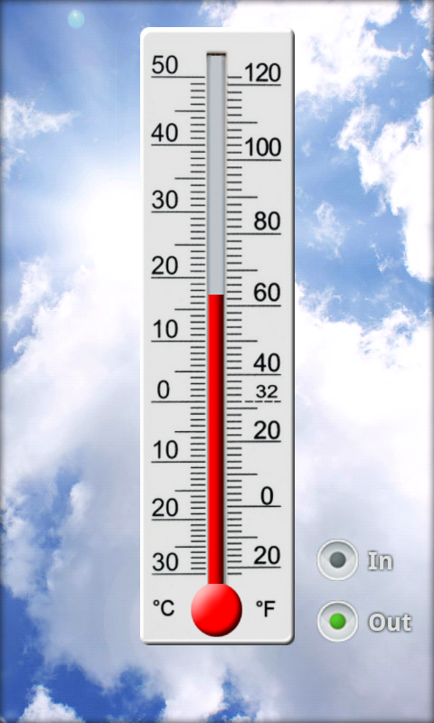
It is…
Freezing Cold Mild Warm Humid Hot Roasting

Slide 11
There is a rainbow

Slide 12
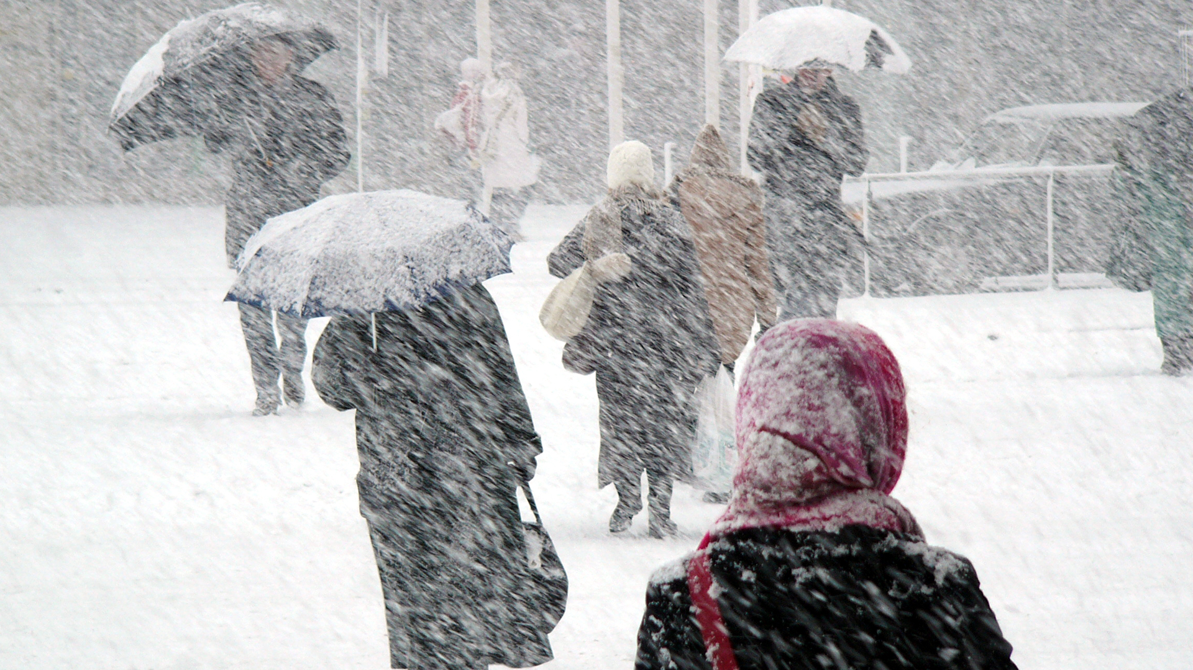
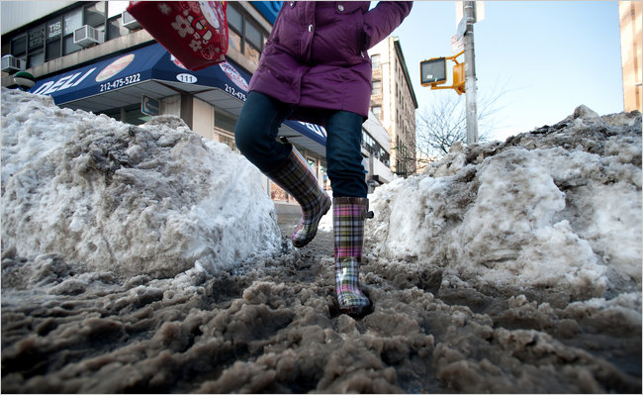
There is sleet, slush or a blizzard

Slide 13
It’s frosty

Slide 14
Morning dew

Slide 15
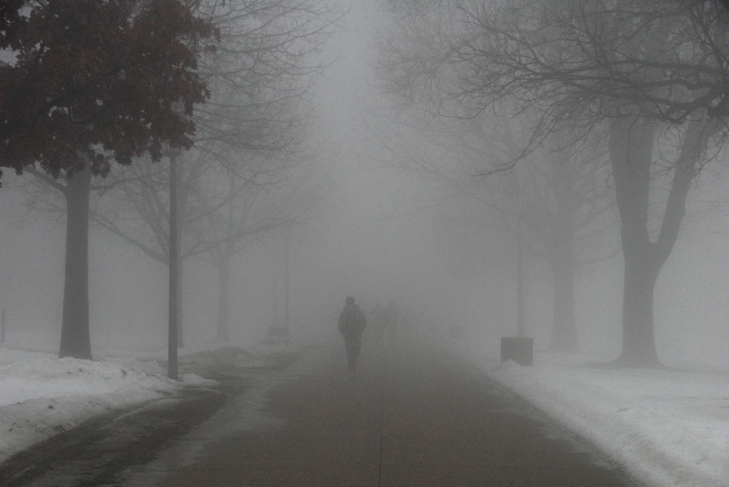
It is misty, it is foggy

Slide 16
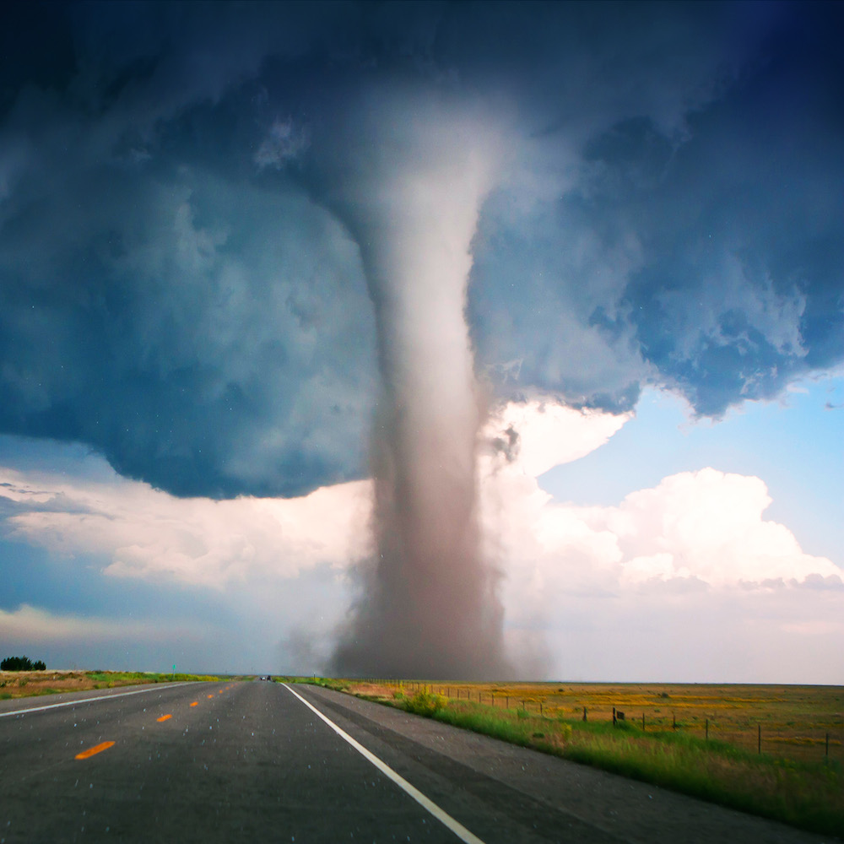
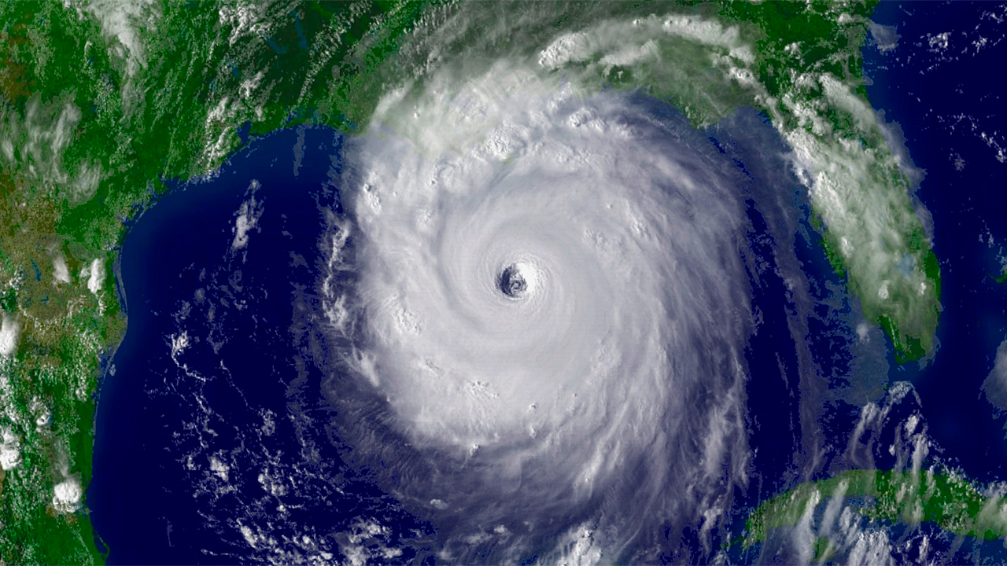
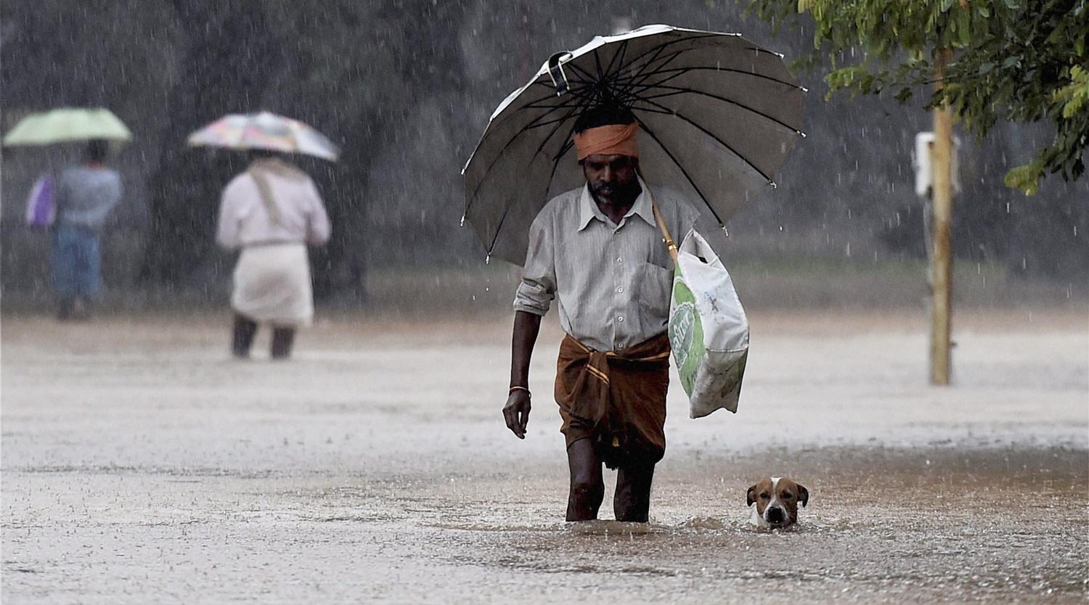
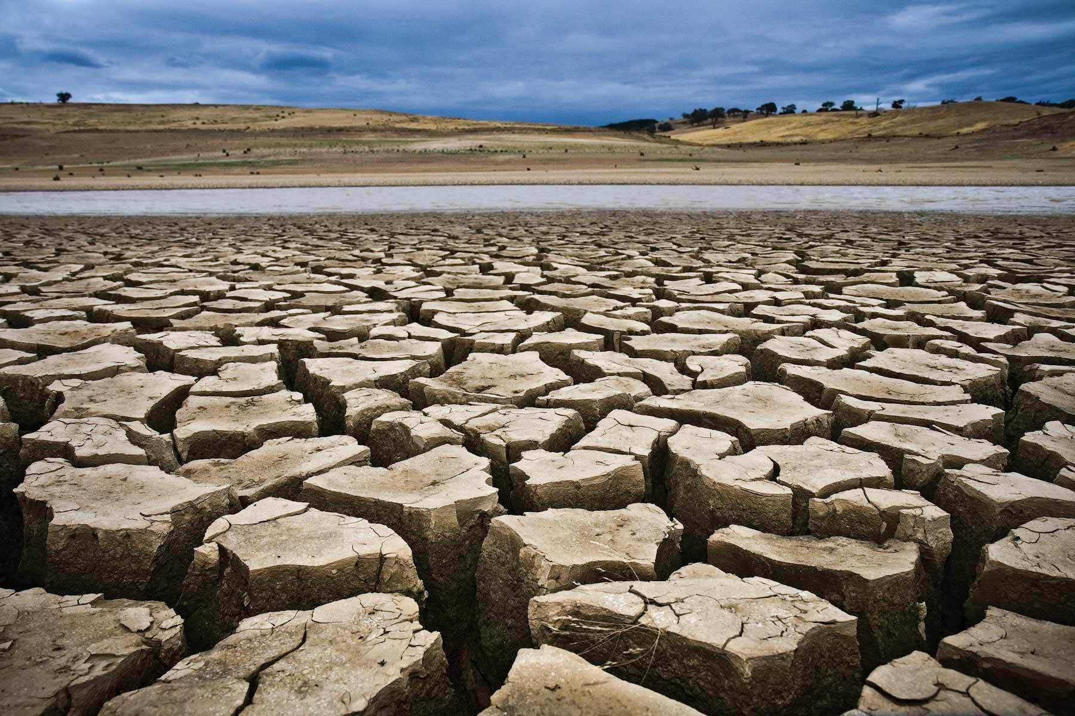
Freaky Weather!
There is a tornado | There is a hurricane
It is flooded | There is a drought

Slide 17
British weather:
What’s the temperature?
It’s muggy today
It’s pouring
It’s hammering it down
There’s a downpour
I got caught in the rain!
There’s a blanket of snow
A wet night tonight
It’s clearing up or it’s brightening up

Slide 18
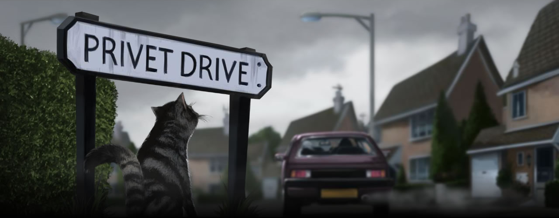
Harry Potter!
The newsreporter allowed himself a grin. "Most mysterious. And now, over to Jim McGuffin with the weather. Going to be any more showers of owls tonight, Jim?" "Well, Ted," said the weatherman, "I don't know about that, but it's not only the owls that have been acting oddly today. Viewers as far apart as Kent, Yorkshire, and Dundee have been phoning in to tell me that instead of the rain I promised yesterday, they've had a downpour of shooting stars! Perhaps people have been celebrating Bonfire Night early -- it's not until next week, folks! But I can promise a wet night tonight."

Slide 19
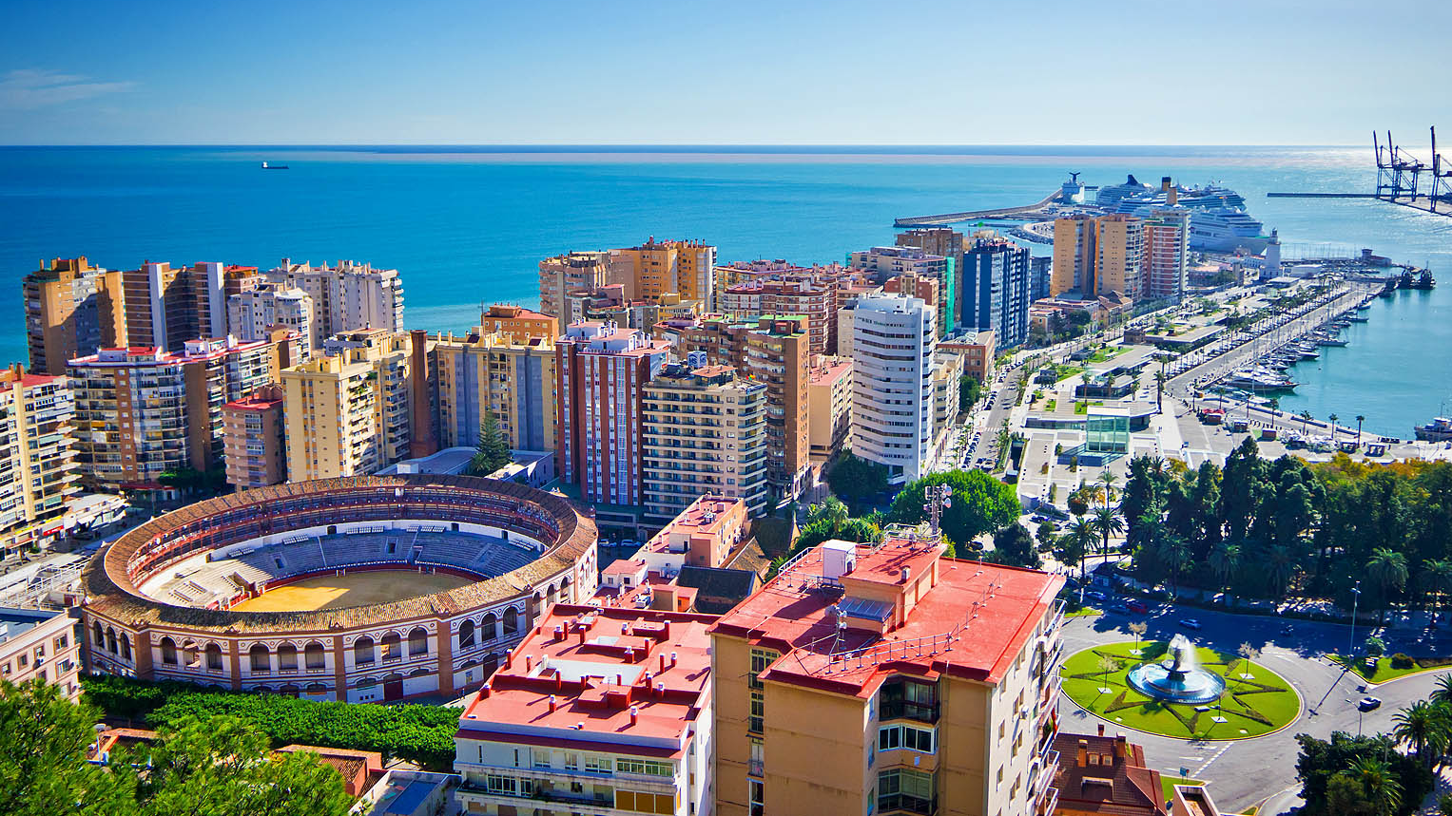
What’s the weather like in…
Malaga

Slide 20
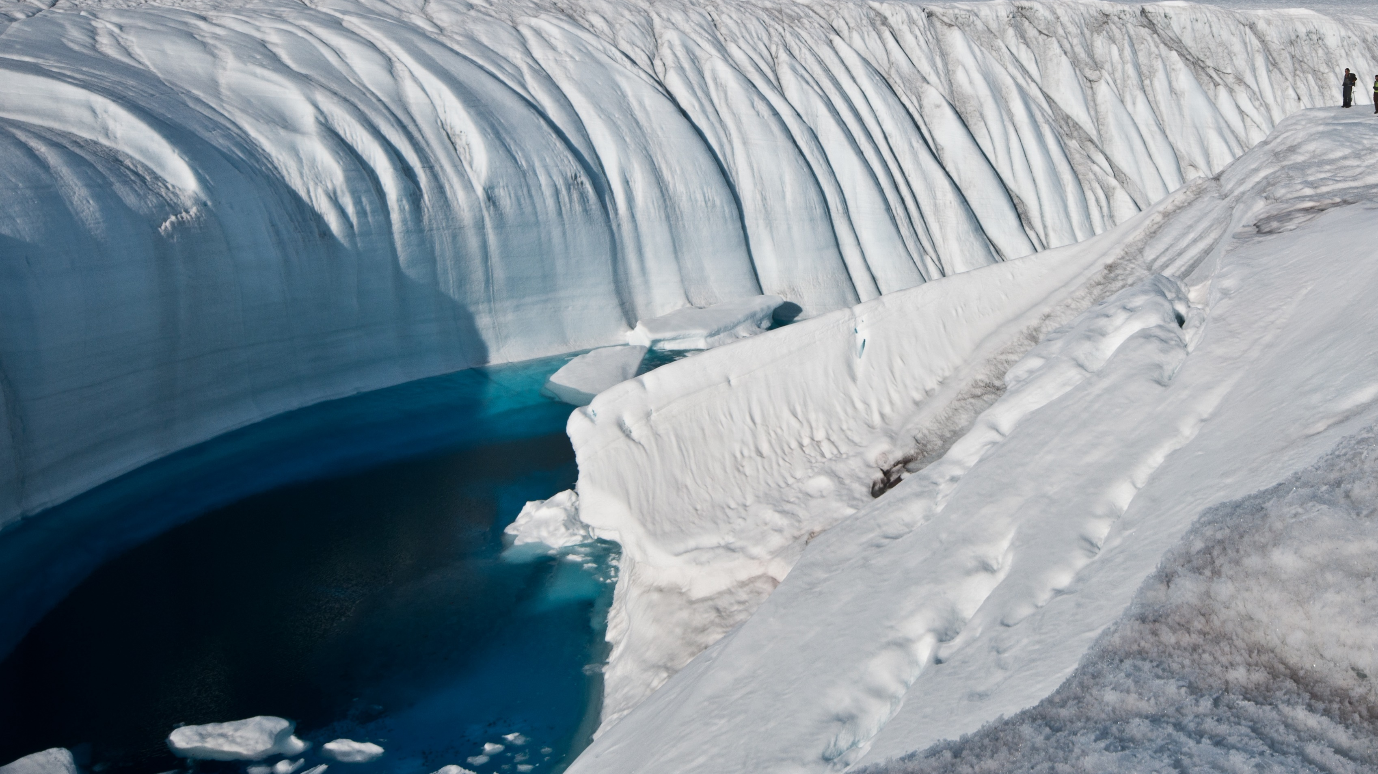
What’s the weather like in…
The North Pole

Slide 21
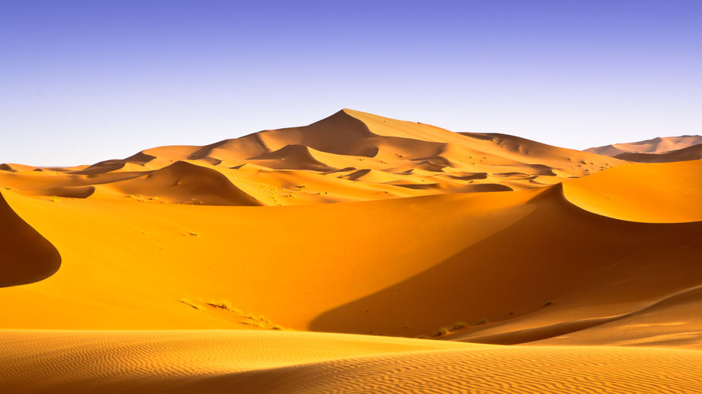
What’s the weather like in…
The Sahara Desert

Slide 22
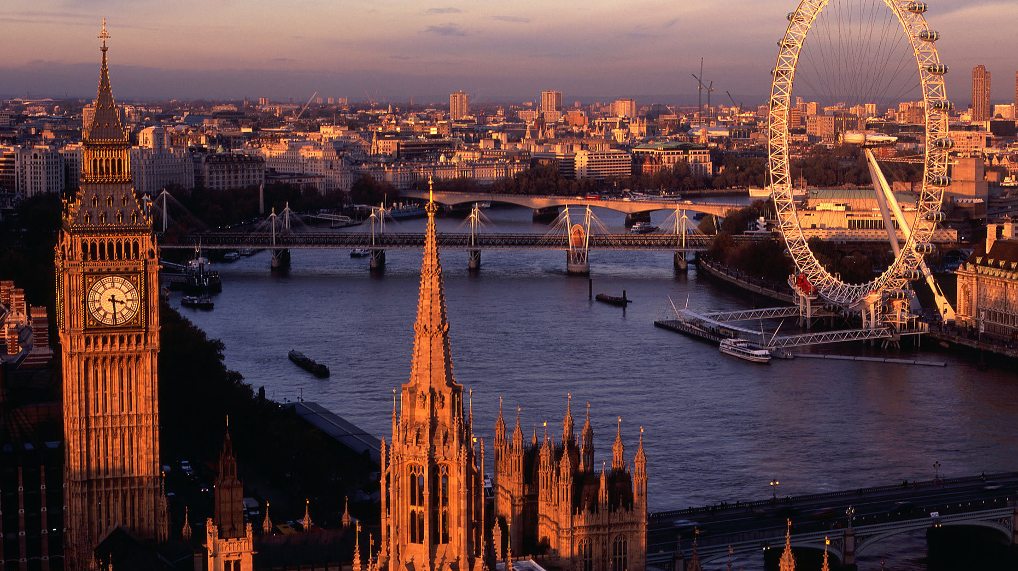
What’s the weather like in…
London

Slide 23
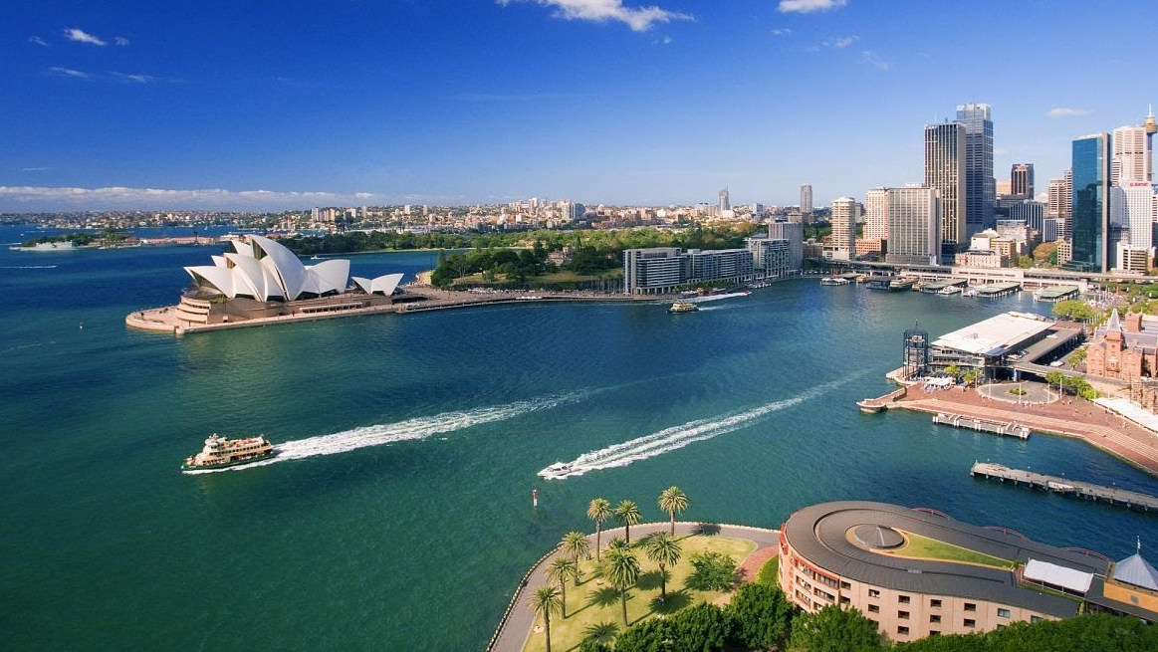
What’s the weather like in…
Australia

Slide 24
Which countries suffer from?
A drought
Hurricanes
Tornados
Floods
Tidal waves

Slide 25
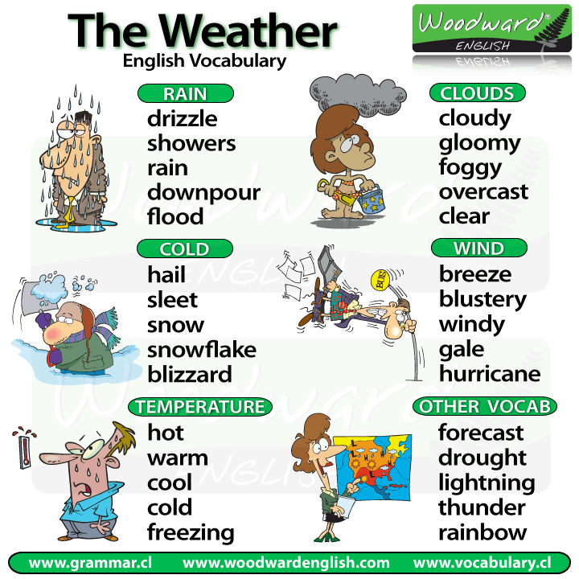

Slide 26
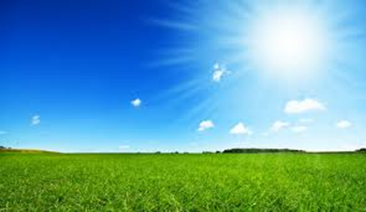

Slide 34
It is…

Slide 38
Freaky Weather!

