Slide 1
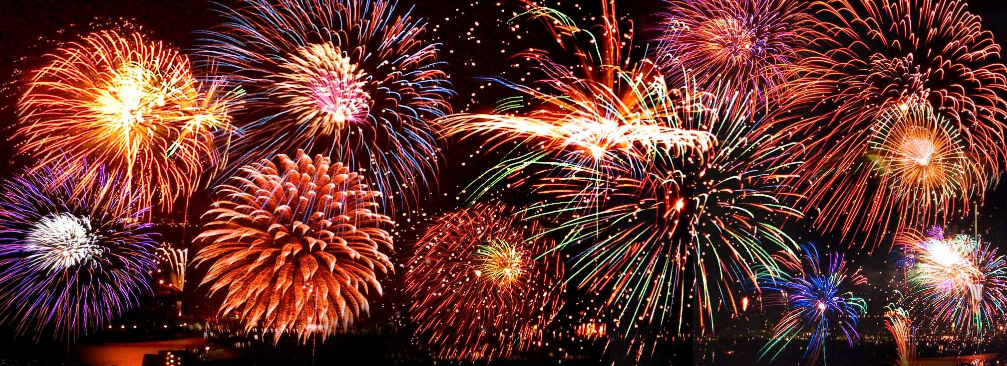
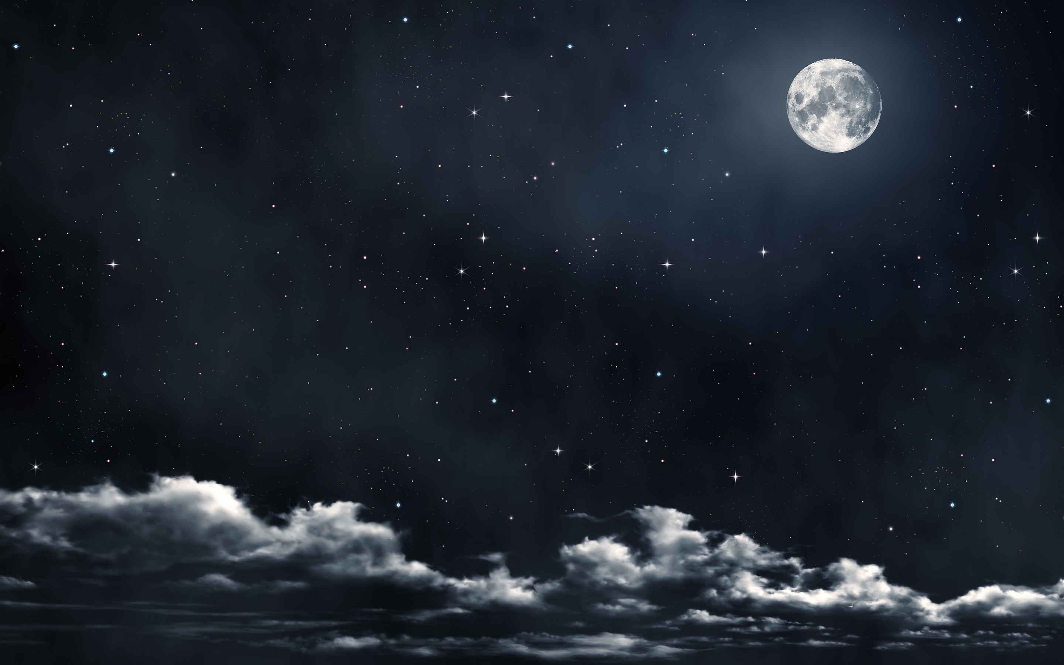
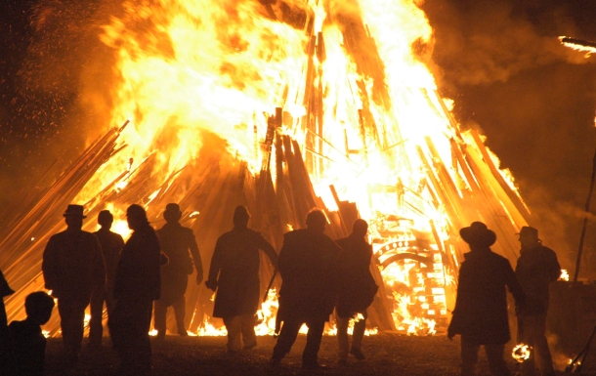
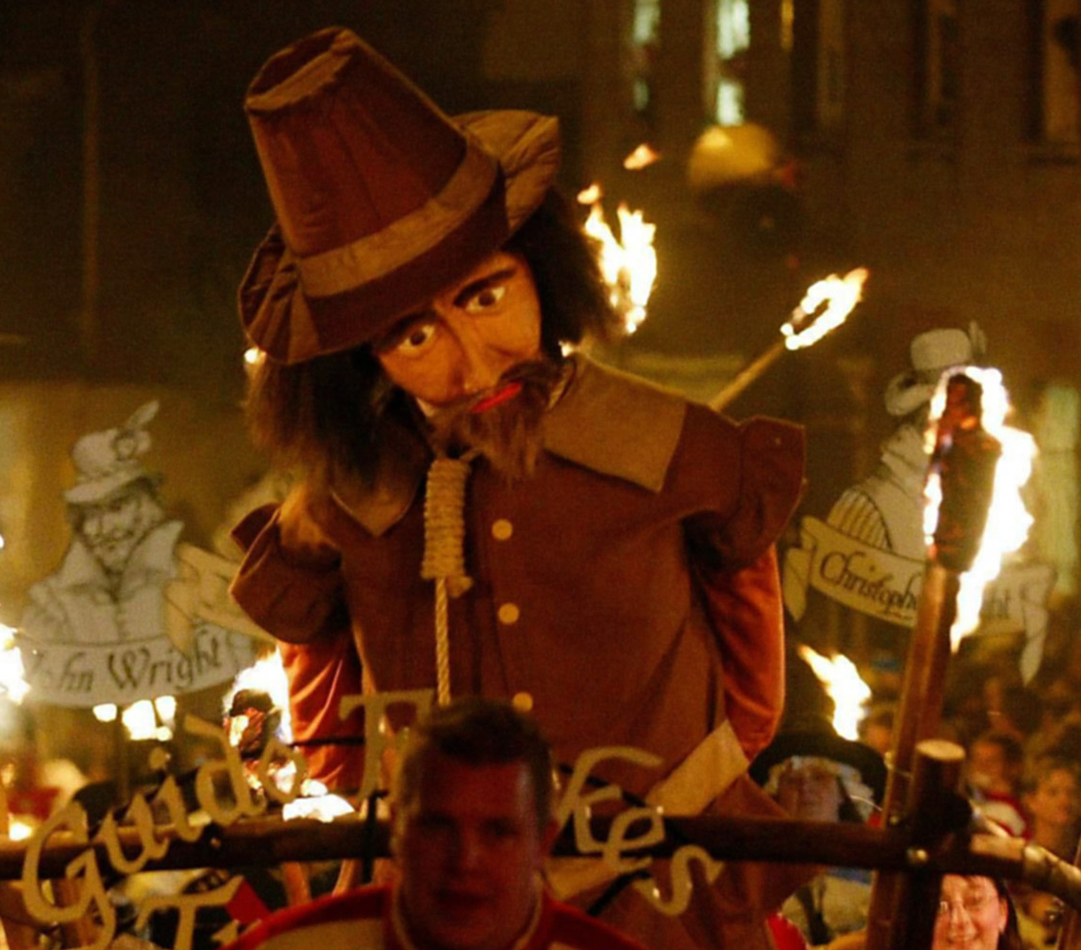
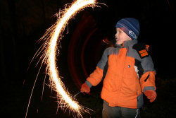

Slide 2
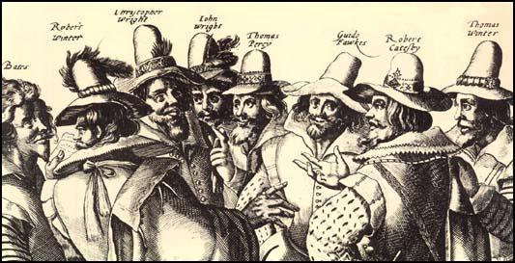
The Gunpowder Plot
Bonfire Night
Remember, Remember the 5th of November, gunpowder, treason and plot should never be forgot!

Slide 3
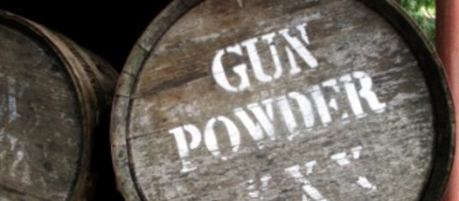
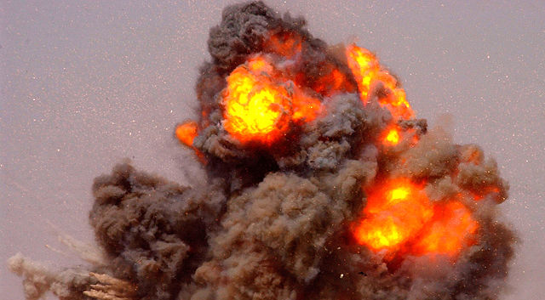
Key Vocabulary
Blow up
Gunpowder
A plot
Conspirators
Catholic or Protestant
Guy Fawkes
Parliament
Bonfire
Fireworks
https://www.youtube.com/watch?v=LWDjhjKXedE

Slide 4
Read and answer:
The year was 1605 and some English Catholics were angry because the King of England, James the first, was treating them badly. In November 1605 a group of men made a plan to blow up the Houses of Parliament (the government buildings) in London. An enormous explosion was planned for November 5th. This was the day that the King was due to open parliament. The plan is known as the ‘Gunpowder Plot’ and the leader of the group was called Robert Catesby. The 13 men put 36 barrels of gunpowder (a type of explosive) in the Houses of Parliament and they waited for the King to arrive. The group decided that Guy Fawkes should light the gunpowder and cause the explosion. The police found the gunpowder before it exploded and they caught all the men involved in the plot. The men were tortured and killed. To celebrate his survival, King James ordered the people of England to have a bonfire on the night of November 5th.

Slide 5
Bonfires, Guys and fireworks
On November 5th people remember the plot to blow up the Houses of Parliament by celebrating ‘Bonfire Night’. All over Britain there are firework displays and bonfires with models of Guy Fawkes, which are burned on the fire. The Guy is made of old clothes and the clothes are filled with newspaper. The Guy is a reminder of Guy Fawkes. The fireworks are a reminder of the gunpowder that Guy Fawkes hid in the cellar of Parliament. In main towns and cities there are big bonfires and firework displays. The biggest fireworks display is the Edenbridge Display in Kent. Edenbridge also has the biggest Guy. A 9-metre ‘celebrity’ model is burned there every year. Children are not allowed to buy or play with fireworks. You have to be 18.

Slide 6
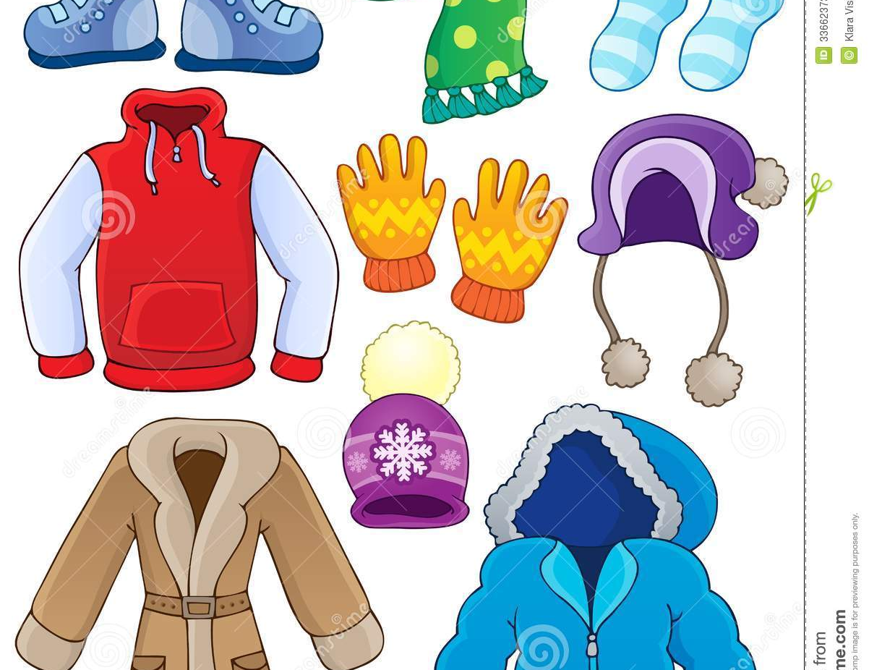
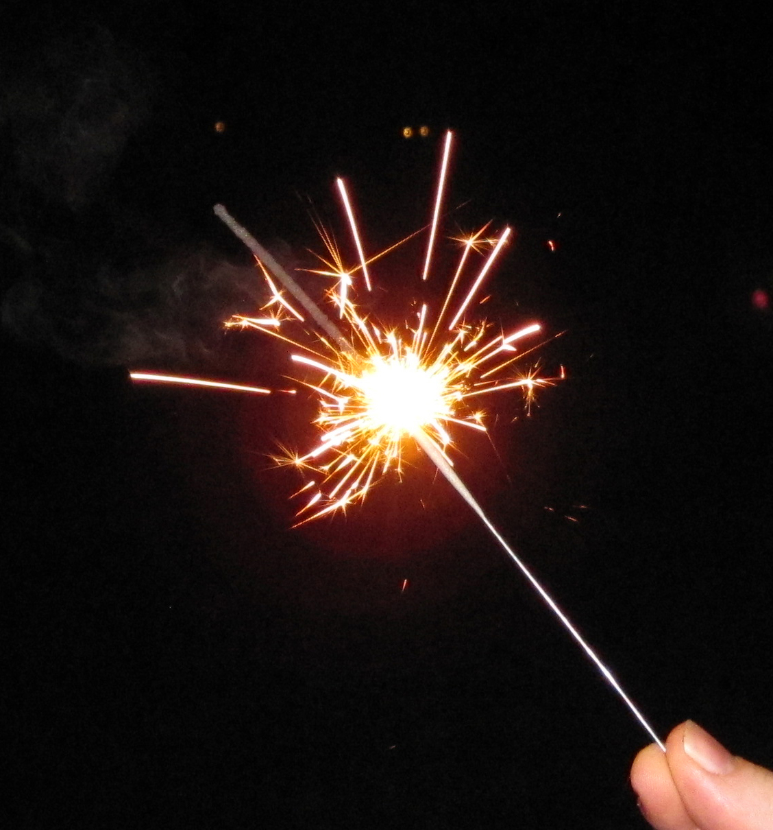
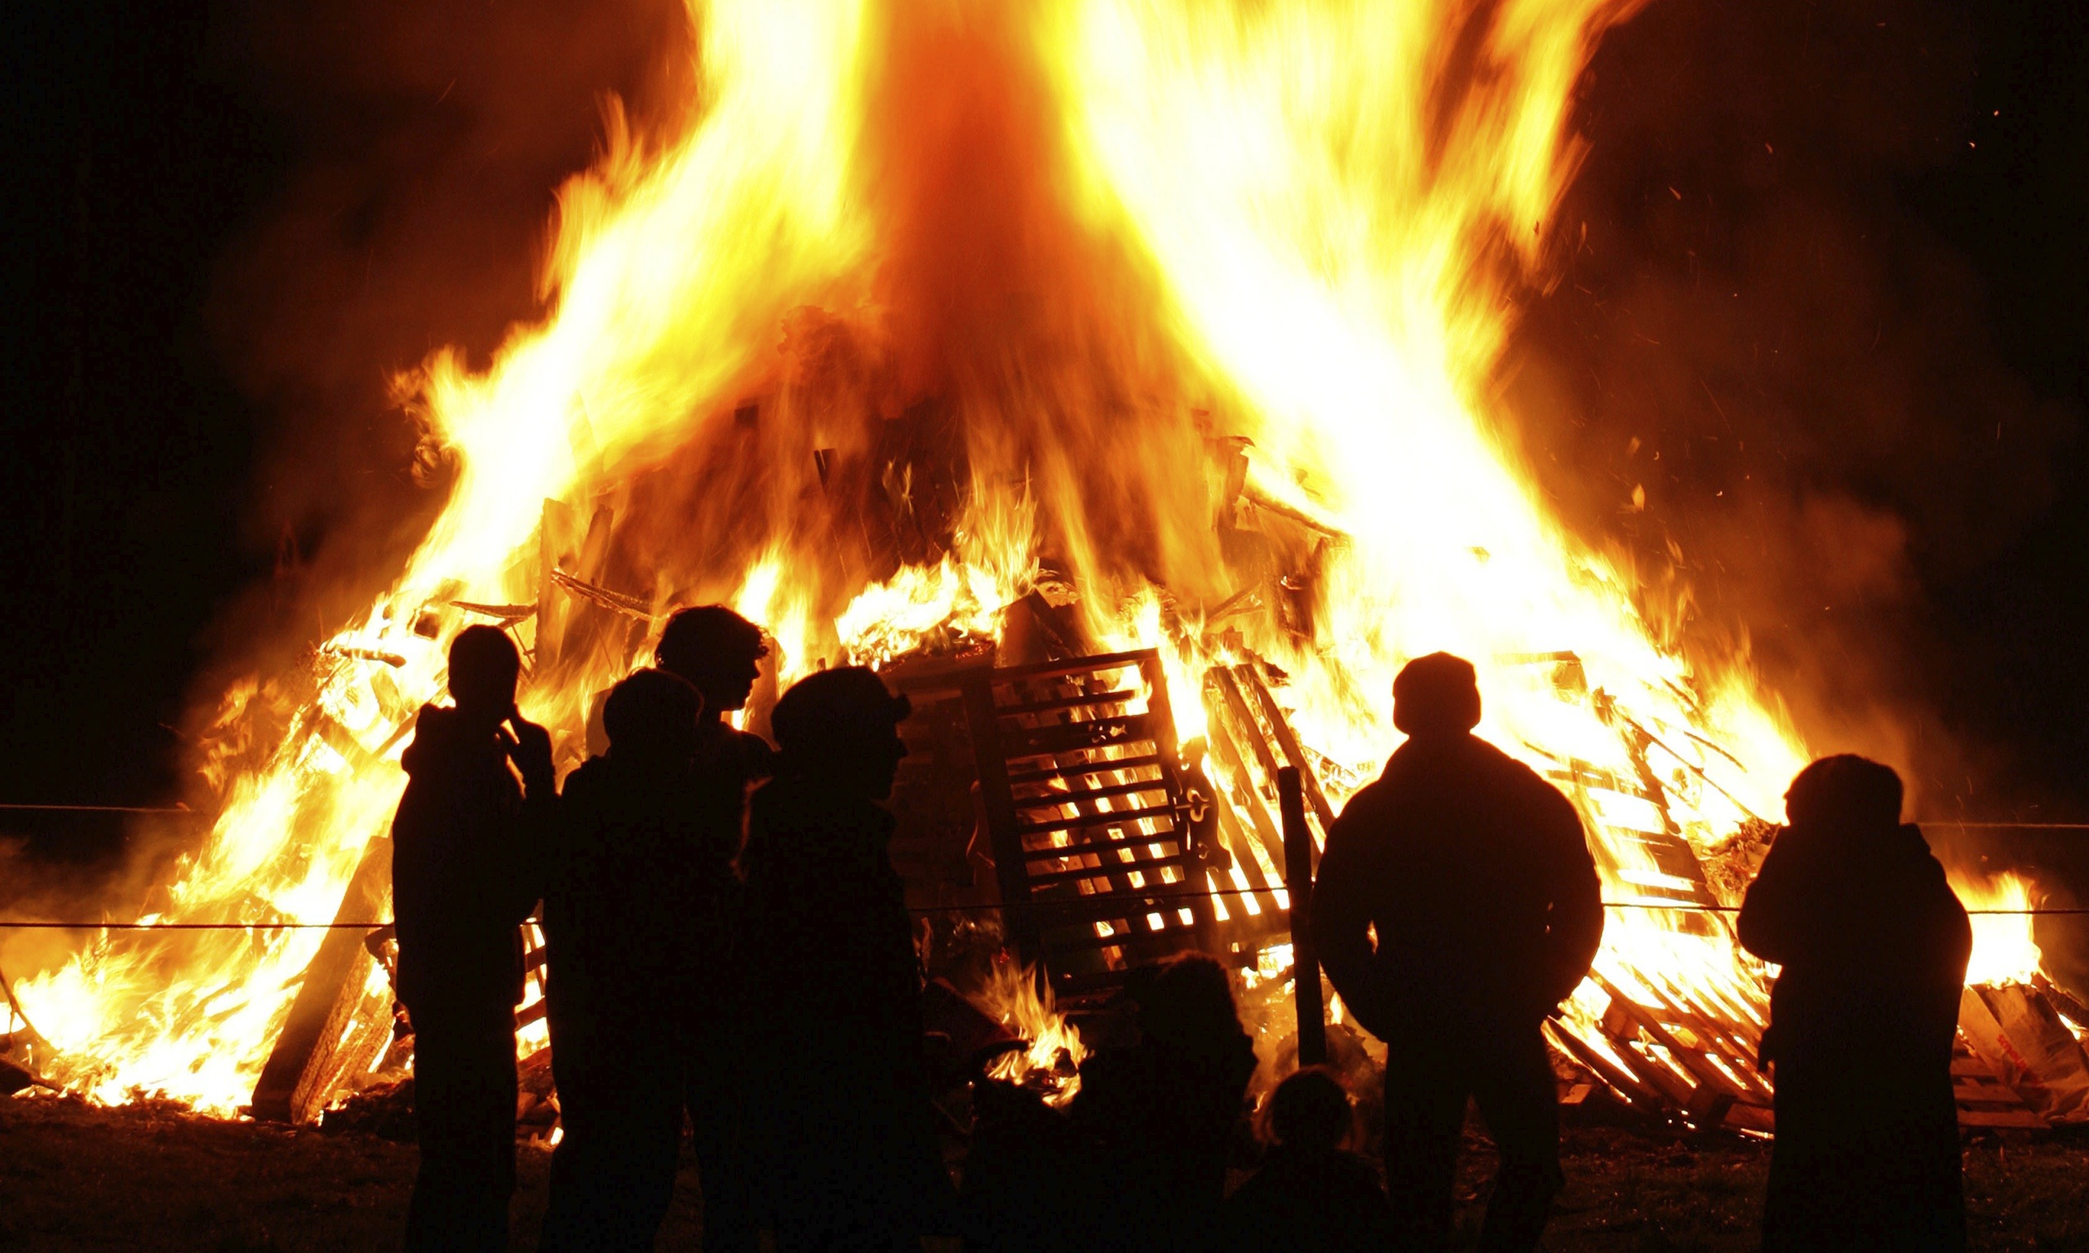
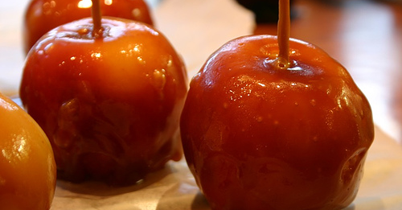
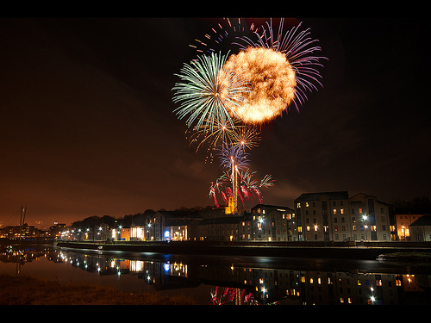
My Bonfire Night

